Slide 1
CITY

Slide 2
# of geo-tweets by category…
% of geo-tweets by category…

Slide 3
TWEET
1,017,040 valid tweets
in range [(-80.10,40.36),(-79.86,40.51)]
from 01/22/2014 to 11/7/2015
TEXT
EMOJI
VADER
EMOJI RANK
TEXT SENTIMENT
EMOJI SENTIMENT
TWEET SENTIMENT
Dichotomized by stddev=1
- #_happy tweet 151,761 14.92%
- #_unhappy tweets 129,863 12.77%
HAPPY
TWEET
UNHAPPY TWEET

Slide 4
# of happy/unhappy genuine tweets and sum sentiment value…

Slide 5
# of happy/unhappy genuine tweets and sum sentiment value by hour of week…
SUN
MON
TUE
WED
THU
FRI
SAT
% of happy/unhappy genuine tweets and sum sentiment value by hour of week…
SUN
MON
TUE
WED
THU
FRI
SAT

Slide 6
Some findings:
Text and emoji could be used to evaluate the tweet sentiment, in turn to quantify the happiness of a city
There is a daily pattern of tweeting. But when people are posting more happy tweets, they are also posting more unhappy tweets.
The temporal pattern of happiness shows peaks at noon and midnight. And people are much happier during weekends than weekdays.

Slide 7
URBAN AREAS

Slide 8
Identify Pittsburgh “livehoods” from tweet clusters with DBSCAN algorithm
40% data set
Define season by day of year [(60,151),(152,243),(244,344),(345,59)]
Minimum points 250 within 0.0015 coordinate distance (~170m)
Minimum cluster of 500 points
SEASONAL
CLUSTER
MERGE
SUPPER CLUSTER
JOIN
“LIVEHOODS”
NEW CLUSTER
NOISE DATA
CREATE

Slide 9
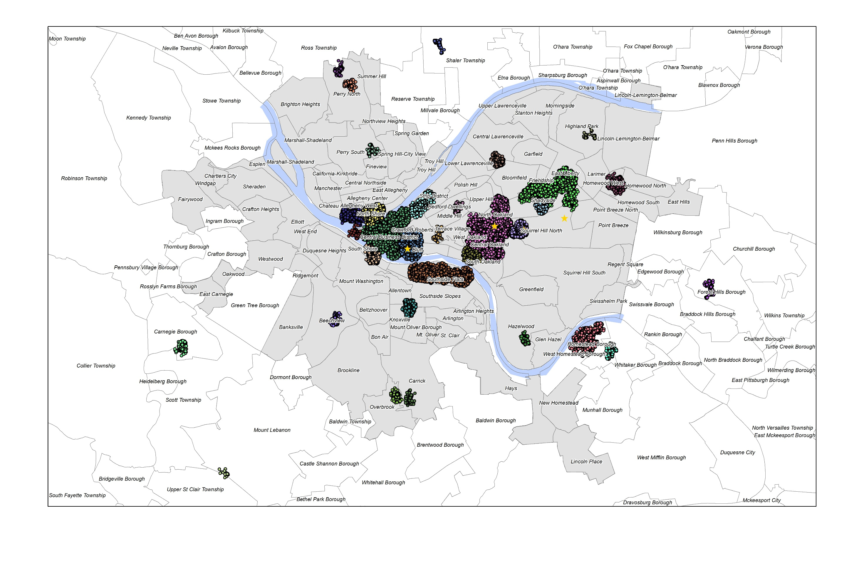

Slide 10
cluster | name | #_tweet | cluster | name | #_tweet | cluster | name | #_tweet | cluster | name | #_tweet
0 | downtown | 40707 | 8 | homewood | 3787 | 16 | beechview | 2025 | 24 | carnegie borough | 1257
1 | oakland | 34123 | 9 | homestead-waterfront | 3643 | 17 | upper st clair township-mount lebanon | 1890 | 25 | foresthills borough | 1203
2 | southside | 17343 | 10 | pittsburgh tech center | 2995 | 18 | terrace village | 1768 | 26 | homestead | 1170
3 | console energy center | 14483 | 11 | cmu | 2513 | 19 | lawrenceville-liberty & bloomfield | 1742 | 27 | middle hill | 1060
4 | northside-pnc park | 11300 | 12 | southside-brownsville & allington | 2362 | 20 | shaler township | 1606 | 28 | hazelwood | 1000
5 | northside-heinz field | 8274 | 13 | overbrook | 2280 | 21 | perry north-ross township | 1487 | 29 | carrick | 955
6 | shadyside-east liberty | 6821 | 14 | station square | 2278 | 22 | shadyside-walnut | 1348 | 30 | highland park | 919
7 | strip district | 4731 | 15 | point state | 2094 | 23 | perry north | 1266 | 31 | perry south | 527

Slide 11
If we simply consider all tweets of each cluster…
pos_%_top3 | beechview | carnegie borough | station square
 | 20.1 | 19.41 | 18.66
pos_%-neg_%_top3 | terrace village | carnegie borough | shadyside-walnut
 | 11.71 | 10.34 | 10.16
senti_avg_top3 | carnegie borough | shadyside-walnut | terrace village
 | 0.21 | 0.18 | 0.18
neg_%_top3 | homewood | southside-brownsville & allington | perry north
 | 22.92 | 21.34 | 19.43
pos_%-neg_%_bottom3 | homewood | southside-brownsville & allington | middle hill
 | -11.78 | -9.44 | -9.15
senti_avg_bottom3 | homewood | southside-brownsville & allington | middle hill
 | -0.28 | -0.25 | -0.22

Slide 12
However these clusters just seem to be happier/unhappier because of several users…

Slide 13
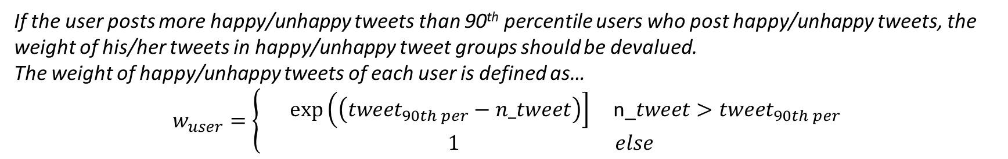
If the user posts more happy/unhappy tweets than 90th percentile users who post happy/unhappy tweets, the weight of his/her tweets in happy/unhappy tweet groups should be devalued.
The weight of happy/unhappy tweets of each user is defined as…
$$w_{user}=\left\{\begin{aligned}\exp\left(\left(tweet_{90th per}−n_tweet\right)\right] \text{n}\text{_}\#\#\#\#\#\#\#\#\#\#tweet>tweet_{90th per}\#\#\# \\ 1 else\end{aligned}\right.$$
pos_%_top3 | station square | terrace village | strip district
 | 16.7103 | 14.256 | 13.1334
pos_%-neg_%_top3 | terrace village | station square | strip district
 | 10.27 | 9.4921 | 7.7766
senti_avg_top3 | terrace village | station square | strip district
 | 0.1573 | 0.1348 | 0.1085
neg_%_top3 | perry south | upper st clair township-mount lebanon | highland park
 | 7.9506 | 6.5126 | 6.2006
pos_%-neg_%_bottom3 | perry south | highland park | perry north
 | -0.9076 | -0.5091 | -0.3027
senti_avg_bottom3 | point state | perry south | highland park
 | -0.203 | -0.0231 | -0.0134

Slide 14
T-test on average cluster tweet sentiment with significant level of 0.1 (sample size=500, iteration=10)
“Y” means the null hypothesis is accepted; “N” means the null hypothesis is rejected
a simple statistical test of the difference of happiness among clusters
(following table shows t-test results of top/middle/bottom clusters ordered by average tweet sentiment)
 |  | 14 | 7 | 13 | 6 | 28 | 16 | 19 | 26 | 30 | 31 | 15
18 | terrace village | N | N | N | N | N | N | N | N | N | N | N
14 | station square |  | Y | N | N | N | N | N | N | N | N | N
7 | strip district |  |  | N | N | N | N | N | N | N | N | N
13 | overbrook |  |  |  | N | N | N | N | Y | Y | N | N
6 | shadyside-east liberty |  |  |  |  | N | N | Y | N | N | N | N
28 | hazelwood |  |  |  |  |  | N | N | N | N | N | N
16 | beechview |  |  |  |  |  |  | Y | N | N | N | N
19 | lawrenceville-liberty & bloomfield |  |  |  |  |  |  |  | N | N | N | N
26 | homestead |  |  |  |  |  |  |  |  | Y | N | N
30 | highland park |  |  |  |  |  |  |  |  |  | N | N
31 | perry south |  |  |  |  |  |  |  |  |  |  | N
15 | point state

Slide 15
Temporal tweet sentiment of the happiest and least happy clusters, equal vs unequal weighted…

Slide 16
Temporal tweet sentiment of the happiest and least happy clusters, equal vs unequal weighted…

Slide 17
Temporal tweet sentiment of the happiest and least happy clusters, equal vs unequal weighted…

Slide 18
Temporal tweet sentiment of the happiest and least happy clusters, equal vs unequal weighted…

Slide 19
Temporal tweet sentiment of the happiest and least happy clusters, equal vs unequal weighted…

Slide 20
Temporal tweet sentiment of the happiest and least happy clusters, equal vs unequal weighted…

Slide 21
Some findings:
For small clusters (e.g. Terrace Village, Perry North, Perry South and Highland Park), the tweet sentiment is much more event-related, while larger clusters (e.g. Station Square and Strip District) show some temporal patterns.
Several users do have impacts on the overall sentiment level, especially for small clusters.
Case study: some “unhappy” days for Station Square and Highland Park…
2015-10-02 | BelowThaaBelt_ | He pissing me off
 | BelowThaaBelt_ | I ain't had my coffee this morning...so I'm half dead rn
 | BelowThaaBelt_ | I am too wtf
 | BelowThaaBelt_ | Ion tell my boys shit bout no problems. They TOO hot already
 | BelowThaaBelt_ | I was mad af sending that text
 | jimmyb304 | My shit right herrrr Bar Louie Station Square
2015-10-03 | BelowThaaBelt_ | Can I not like you for a while ?
 | BelowThaaBelt_ | Why do you worry? You know I'm the same.
 | BelowThaaBelt_ | Bad bitches is the only thing that I like
 | BelowThaaBelt_ | You lazy bittches is fucking up the economy
 | BelowThaaBelt_ | Hate when get too attached to me
2015-10-04 | BelowThaaBelt_ | Fuck around &amp; act like I NEVER met to ass
 | Mrstevecooper | Blah blah blah. No one cares bitch. Shut up.
 | Mrstevecooper | *throws chair at the bitch in Human Relations*
 | Mrstevecooper | Imma cut you.
 | Mrstevecooper | I seriously hate using my MasterCard. Creditcard shit sucks.
 | Zizi_Softtail | Gonna chill with furries and shit this weekend
Station Square

Slide 22
2015-06-10 | 311WestOtterman | Lil b blows dead"
 | 311WestOtterman | Or nah o rly fag"
 | 311WestOtterman | sorry my dad wasn't Arthur yeah he wad a pedophile"
 | 311WestOtterman | im pissed
 | 311WestOtterman | imma be on clay ave sellin dis lawwwwwng dick
 | 311WestOtterman | not much left to do but drowned
2015-06-12 | 311WestOtterman | fuck toby &amp; smokey bear
 | 311WestOtterman | bored txt me
 | 311WestOtterman | Why should I even waste my breath anymore.. fwm"
 | 311WestOtterman | GUYS WHO IS ALIANDO??? DONT IGNORE ME PLS what the fuck!
 | 311WestOtterman | Do u rlly no dick bukkis"
 | 311WestOtterman | on &amp;on, reckless abandon
 | 311WestOtterman | hannah, you're actually really dumb
 | XoNyny | Esha be talking shit
2015-06-13 | XoNyny | I forever calls esha miserable
 | 311WestOtterman | i fight animals
 | TylerNolder | fuck this rain
 | 311WestOtterman | look at snap chat dead"
 | 311WestOtterman | kevin harts getting annoying
2015-06-15 | 311WestOtterman | World Cup &gt; baseball gayest shit ive seen all night"
 | 311WestOtterman | no well cry about it no"
 | 311WestOtterman | no well cry about it no k" hockeys on bye"
 | 311WestOtterman | shinners :c
 | 311WestOtterman | Gbg is probably the most lamest city ever fwm"
Highland Park

Slide 23
Some findings:
‘Livehoods’ in a city could identified by clustering tweets.
Happiness is different among urban areas, and could be highly affected by a small group of users.
Devaluing users who post much more happy/unhappy tweets than others in each cluster could help get a better understanding of the overall wellbeing.
Questions:
Is there any sampling issue that causes this problem?
Is tweet or user being randomly chosen?
Considering the lack of data and user effect, the following analysis focuses on large clusters.

Slide 24
Temporal tweet sentiment considering user-weight…

Slide 25
Temporal tweet sentiment considering user-weight…

Slide 26
Temporal tweet sentiment considering user-weight…

Slide 27
Temporal tweet sentiment considering user-weight…

Slide 28
A simple classification based on the temporal sentiment pattern…
Event-based
e.g. PNC Park, Heinz Field
Event Detection
Hybrid
e.g. Downtown, Oakland, Southside, Console Energy Center
Urban Function
Emotion Prediction
Function-based
e.g. Shadyside & East Liberty, Strip District

Slide 29
Weekly tweet sentiment patterns considering user-weight…
SUN
MON
TUE
WED
THU
FRI
SAT
SUN
MON
TUE
WED
THU
FRI
SAT

Slide 30
Weekly tweet sentiment patterns considering user-weight…
SUN
MON
TUE
WED
THU
FRI
SAT
SUN
MON
TUE
WED
THU
FRI
SAT

Slide 31
Weekly tweet sentiment patterns considering user-weight…
SUN
MON
TUE
WED
THU
FRI
SAT
SUN
MON
TUE
WED
THU
FRI
SAT

Slide 32
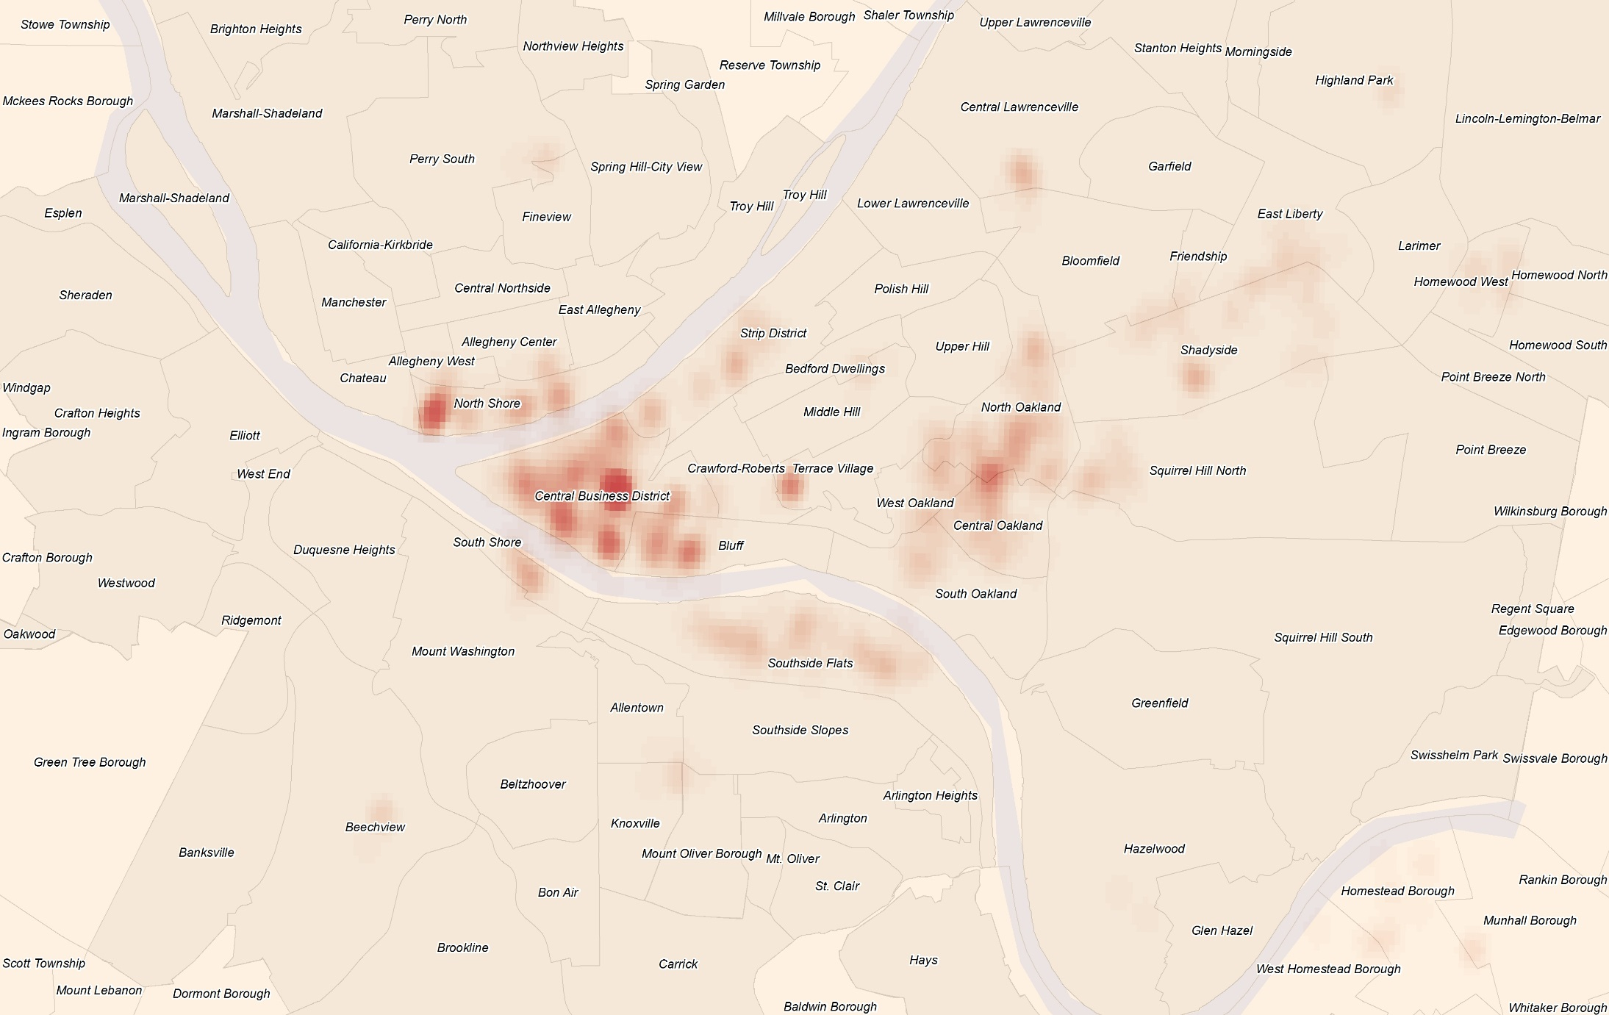
Heat-maps showing spatial-temporal patterns of happy/unhappy tweets…
Weekday midday happy tweets

Slide 33
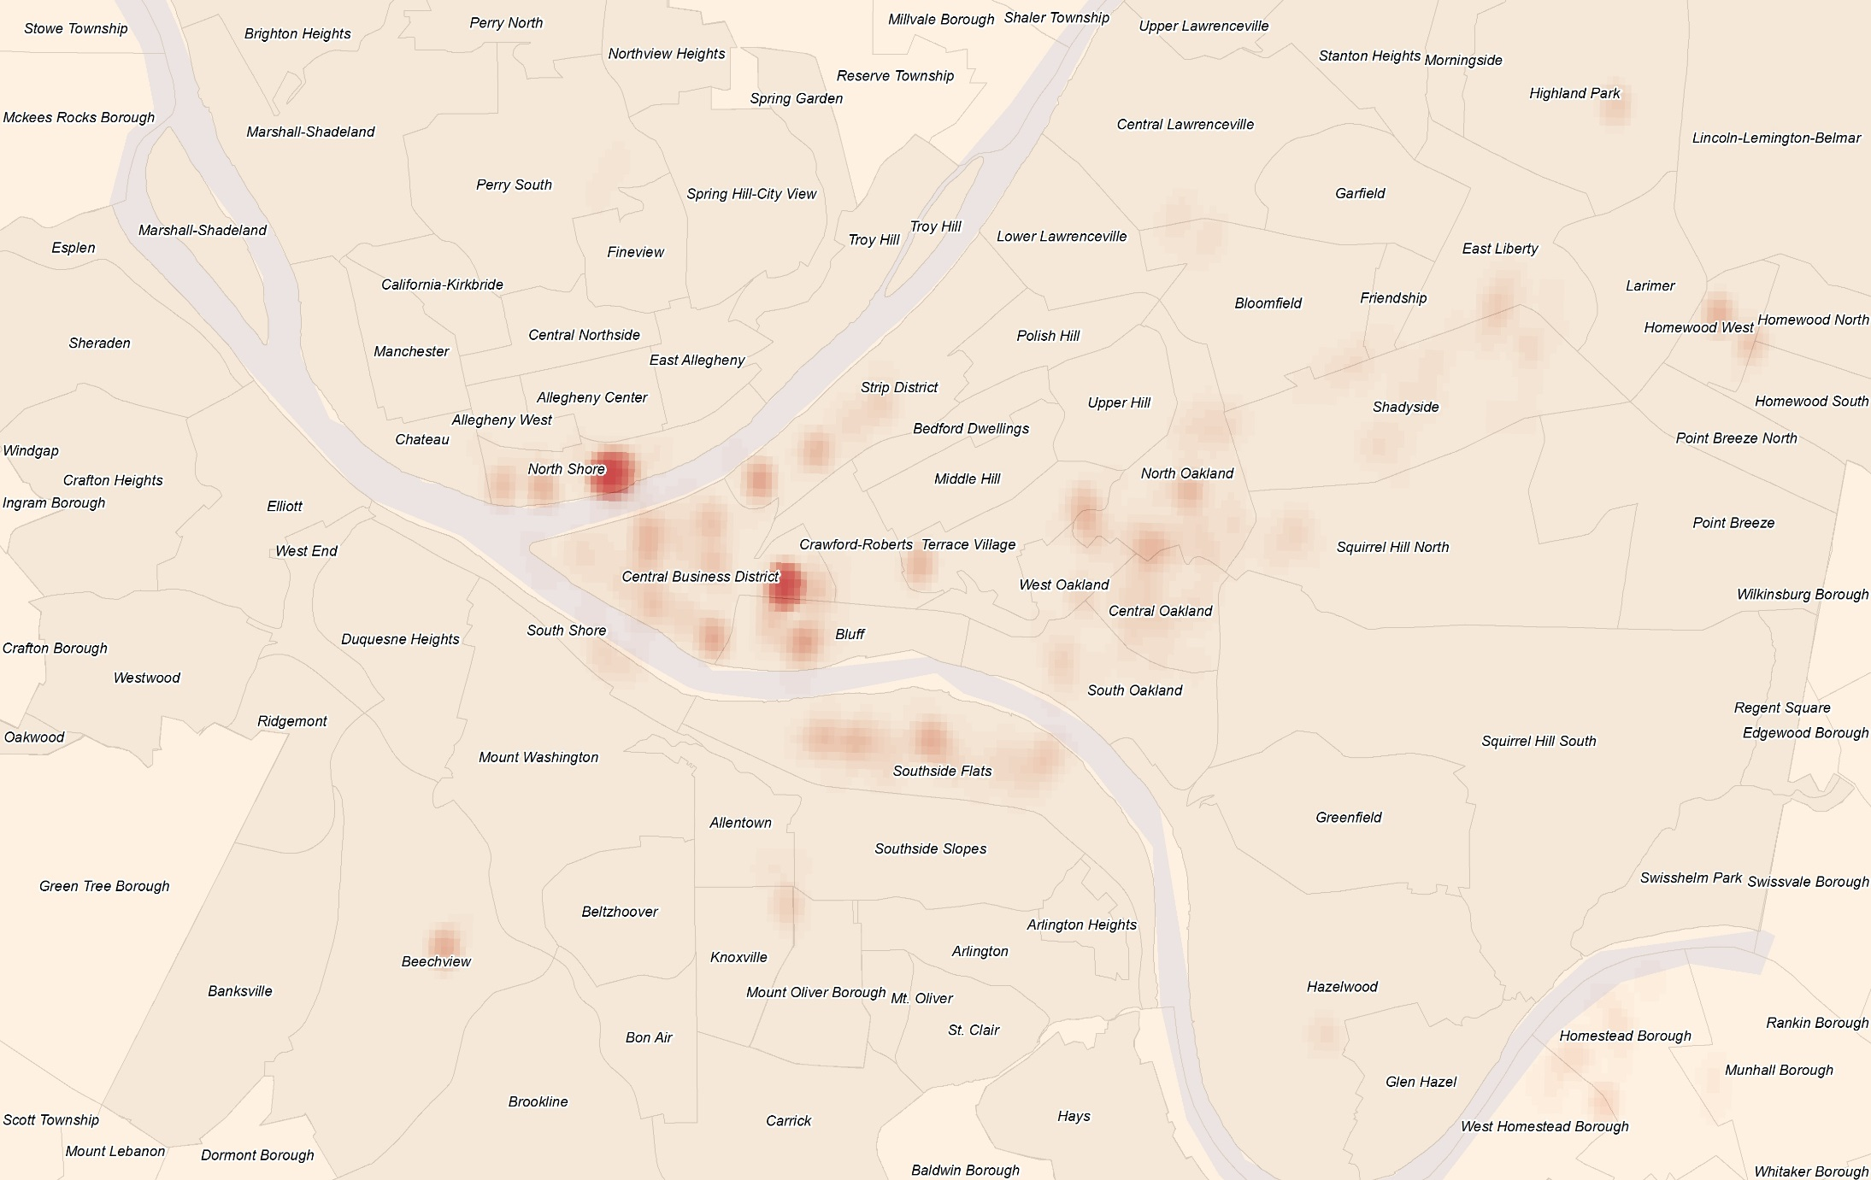
Heat-maps showing spatial-temporal patterns of happy/unhappy tweets…
Weekday midnight happy tweets

Slide 34
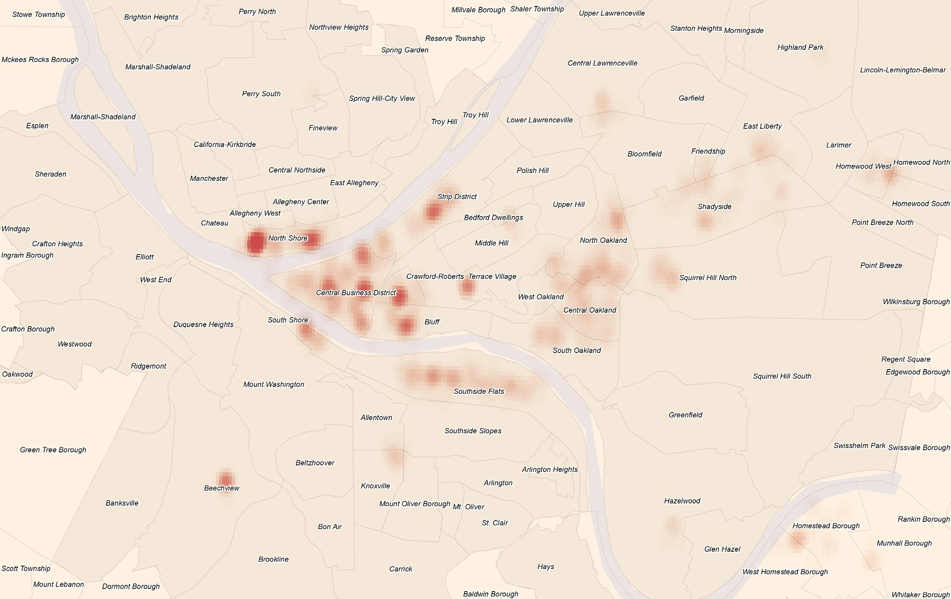
Heat-maps showing spatial-temporal patterns of happy/unhappy tweets…
Weekend afternoon happy tweets

Slide 35
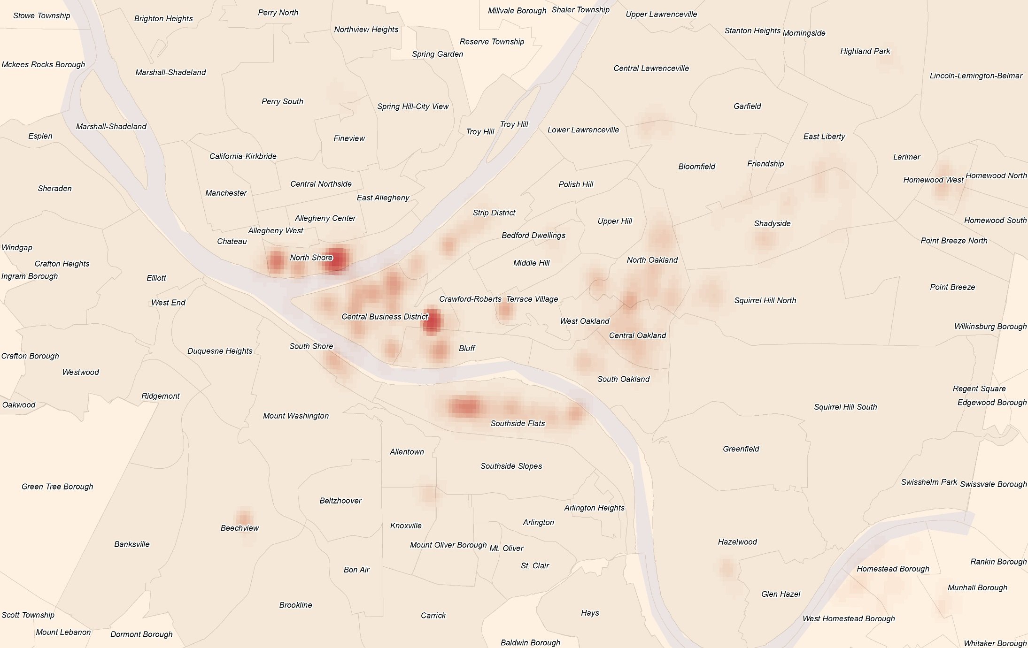
Heat-maps showing spatial-temporal patterns of happy/unhappy tweets…
Weekend midnight happy tweets

Slide 36
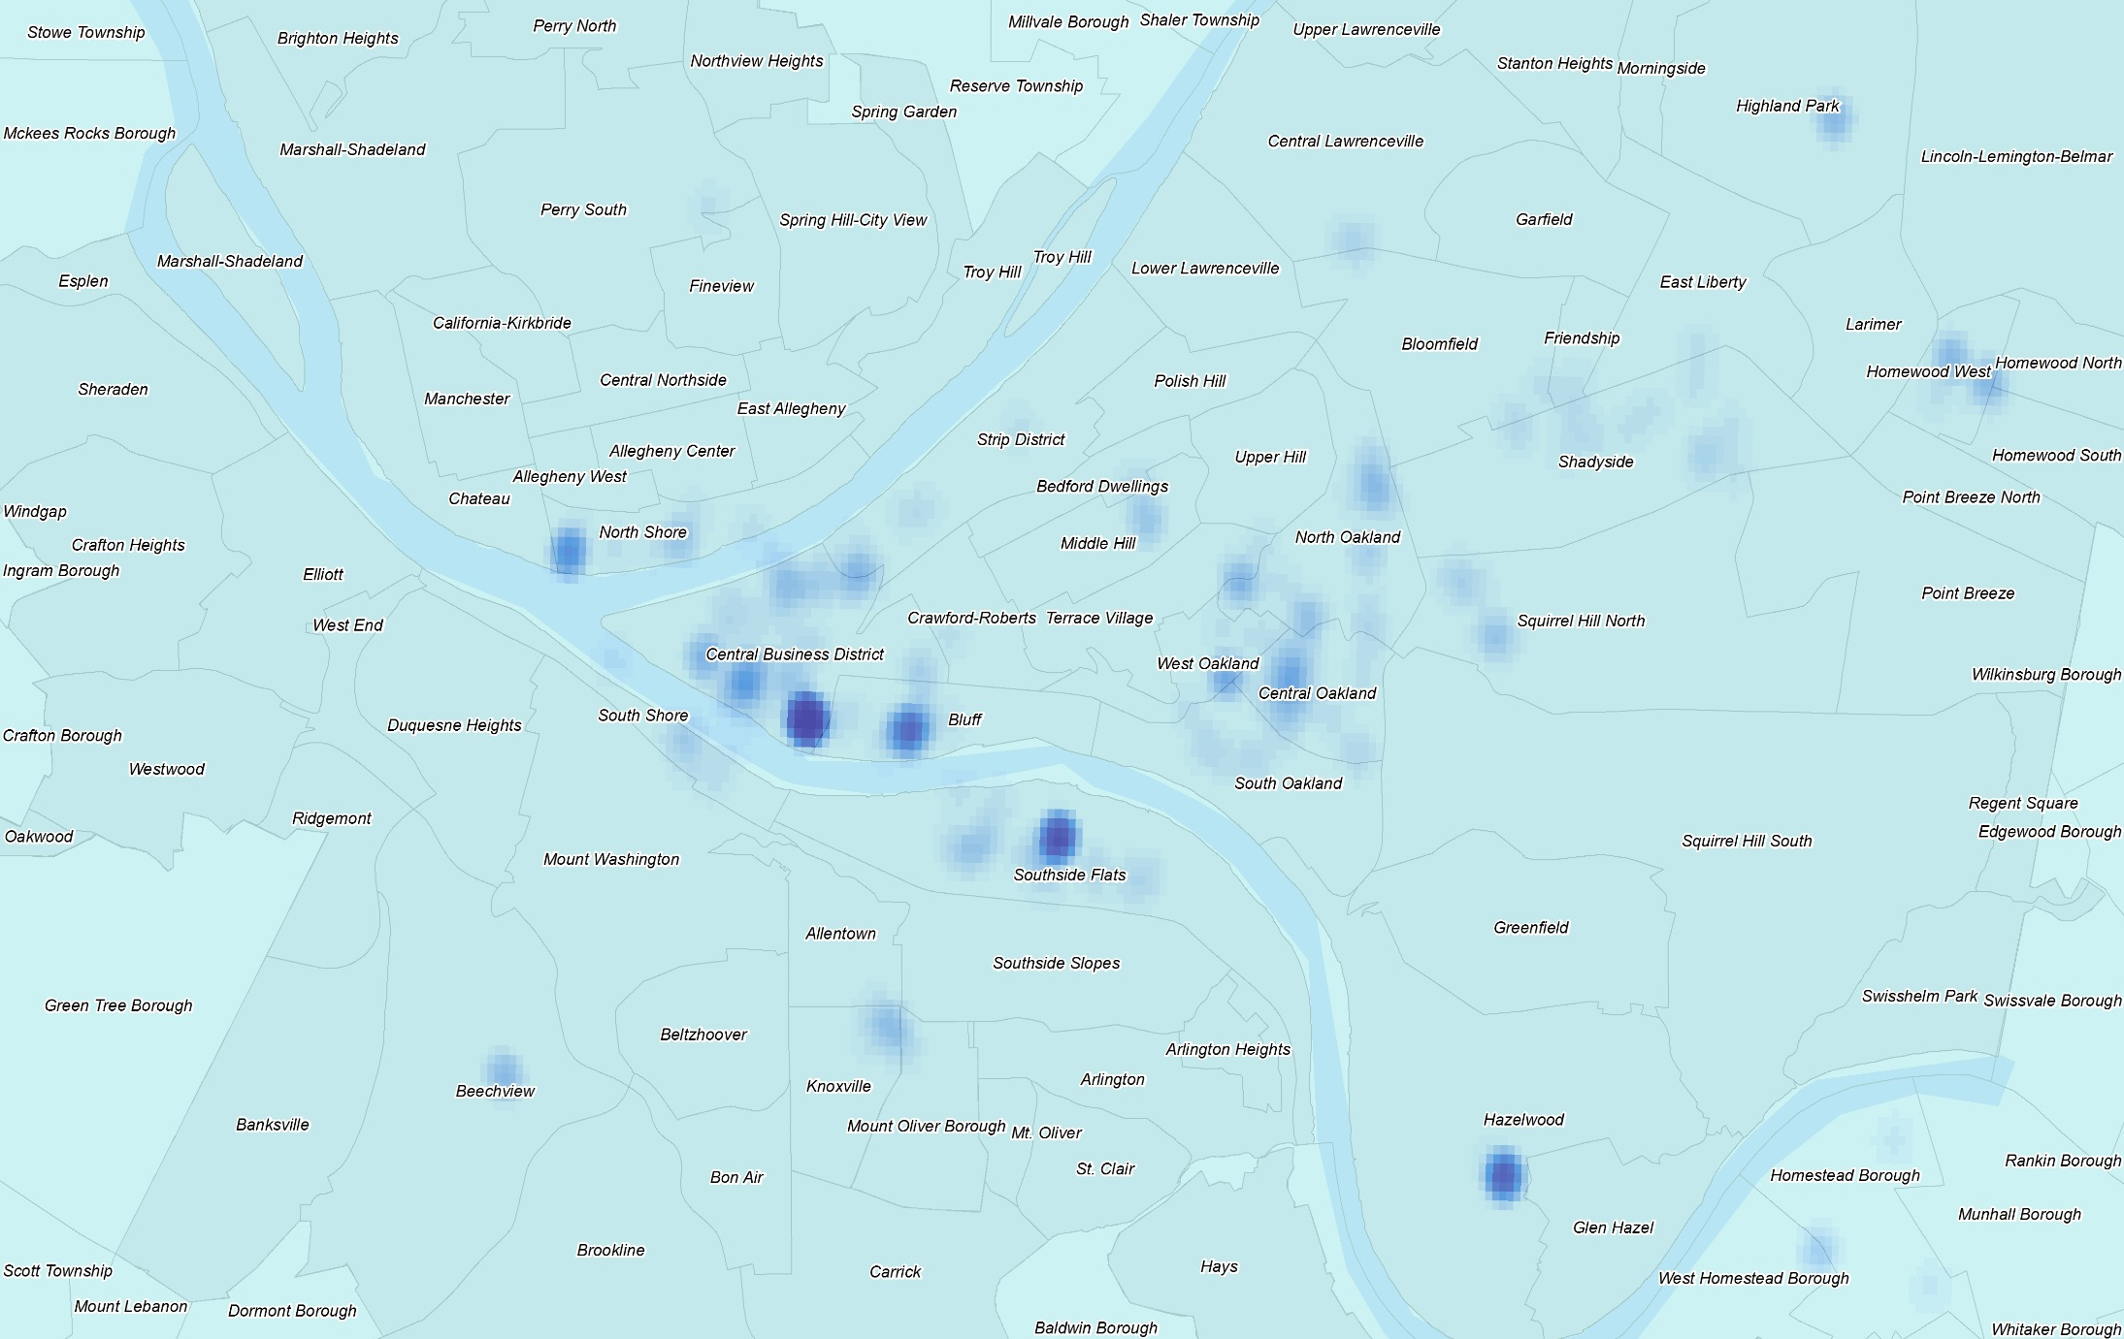
Heat-maps showing spatial-temporal patterns of happy/unhappy tweets…
Weekday morning unhappy tweets

Slide 37
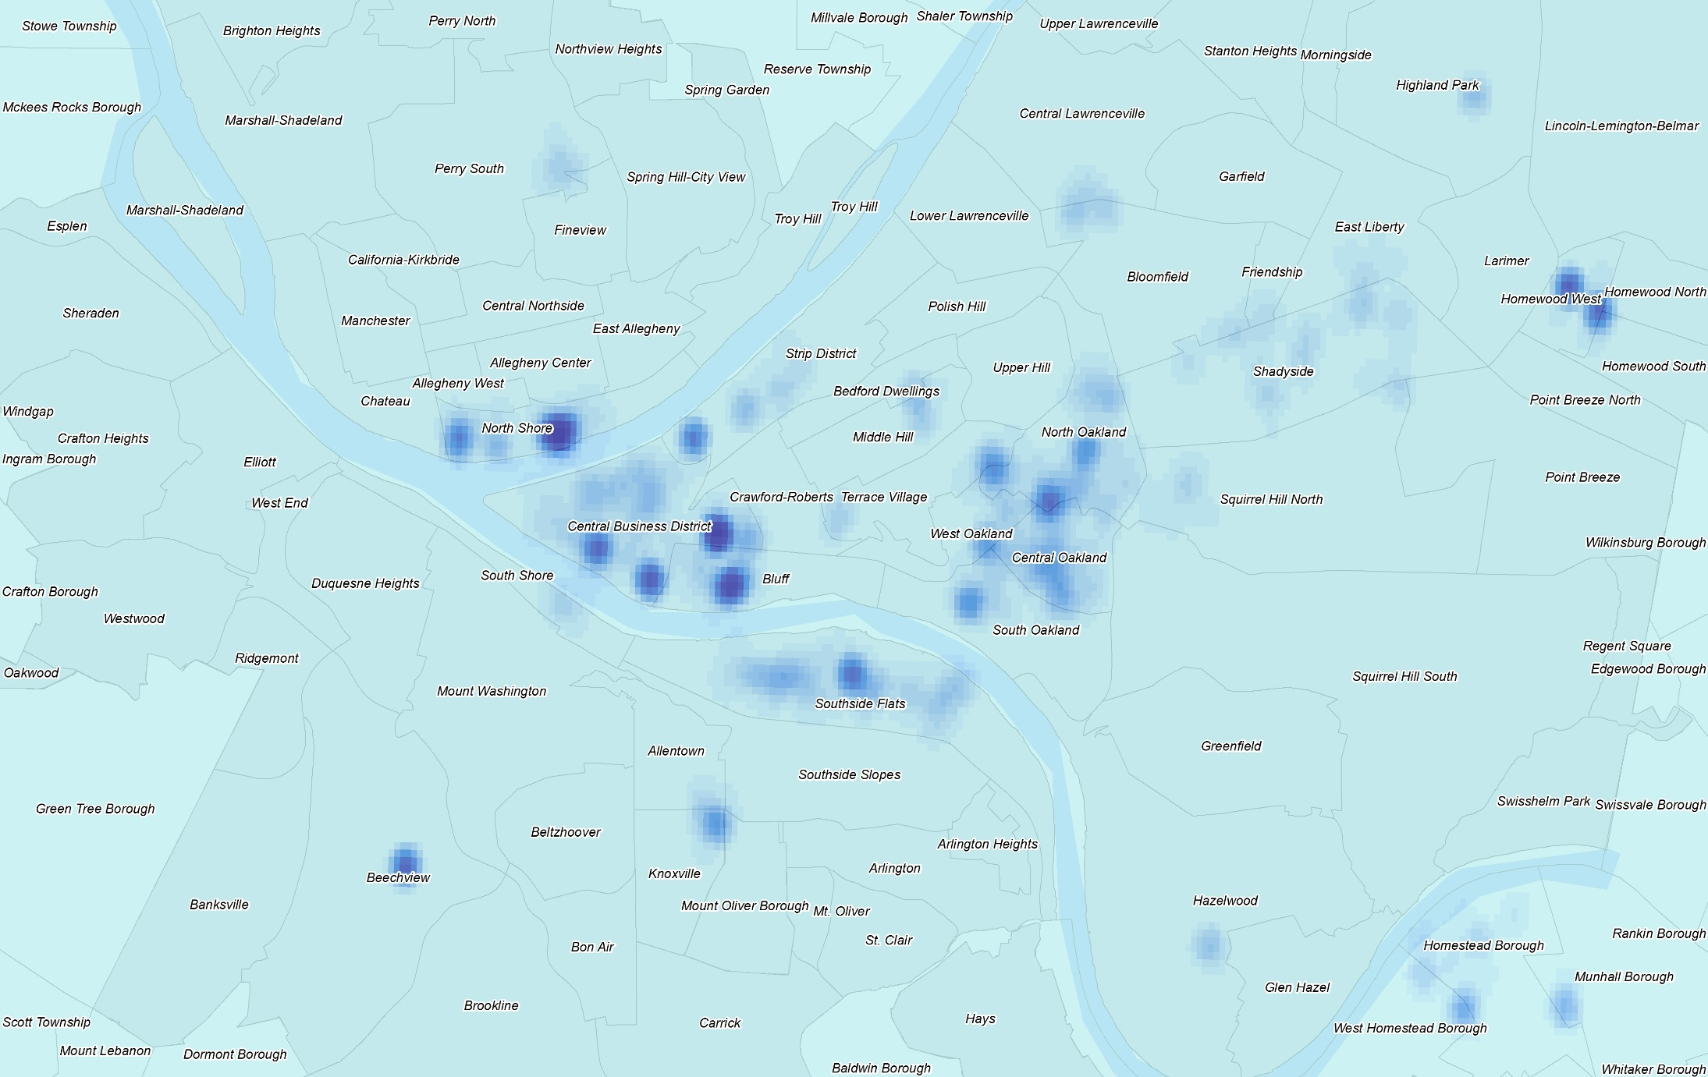
Heat-maps showing spatial-temporal patterns of happy/unhappy tweets…
Weekday midnight unhappy tweets

Slide 38
Some findings:
Urban areas could be classified based on their temporal patterns of happiness. The urban happiness is either event-related or function-related.
Further analysis on the happiness spikes and patterns could help the study of event detection and emotion prediction.
These temporal patterns also give us insights on how different areas perform their urban functions.

Slide 39
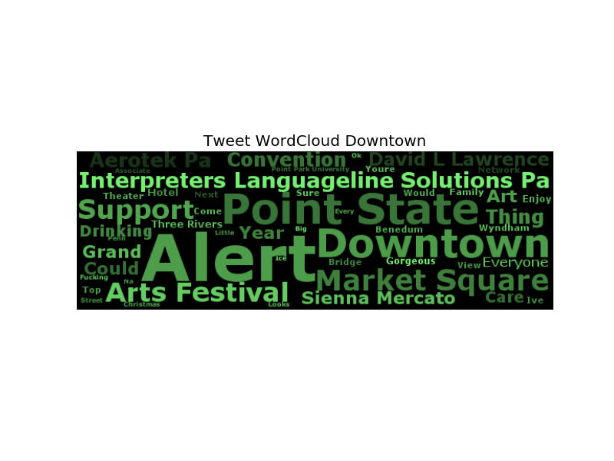
What are the features that generate happiness in each cluster?
Evaluate the importance of a term for a cluster by tf-idf score (term frequence – inverse document frequence)
Considering uni-gram, bi-gram and tri-gram
Merge n-grams after sorting tf-idf score (same word-stem/inclusion/intersection)
Visualize term tf-idf score and correlated tweet sentiment by wordcloud (lighter color and larger size mean higher tf-idf and sentiment value)
However…
Why ‘alert’ has such tf-idf score?
Why ‘interpreters languageline solutions’ is associated with so many happy tweets?

Slide 40
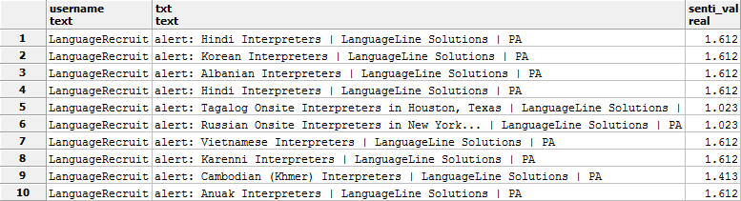
If we search happy tweet in Downtown with keyword ‘alert’ and ‘Interpreters’…
Most tweets containing ‘alert’ are job recruitment posts
Vader gives high sentiment value to “Interpreters … | LanguageLine Solutions | PA”

Slide 41
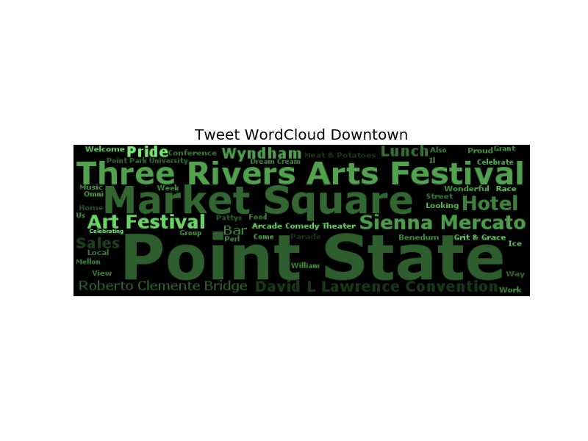
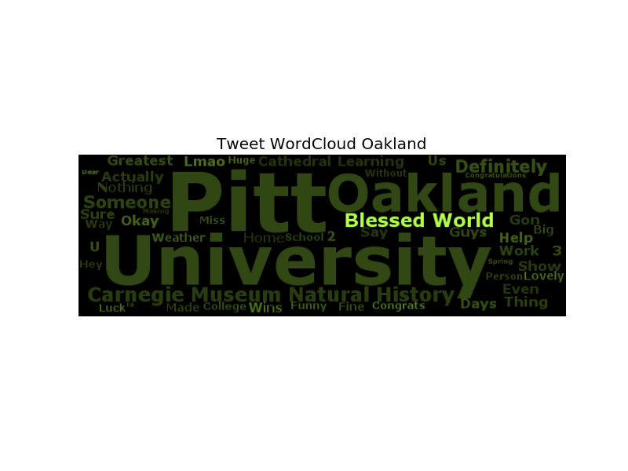
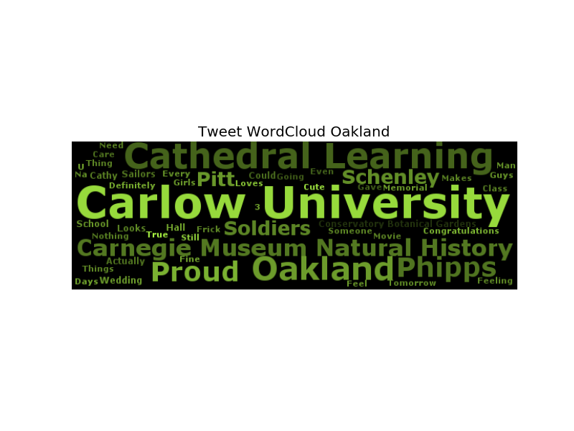
To address this issue, another tf-idf is considered, which evaluates the importance of a term for a specific user.
Therefore, the user-effect could excluded by dividing cluster tf-idf with user tf-idf standard deviation…
Great! ‘Alert’ and ‘Interpreters…’ are no longer popping up.
More terms give identify to Oakland.

Slide 42
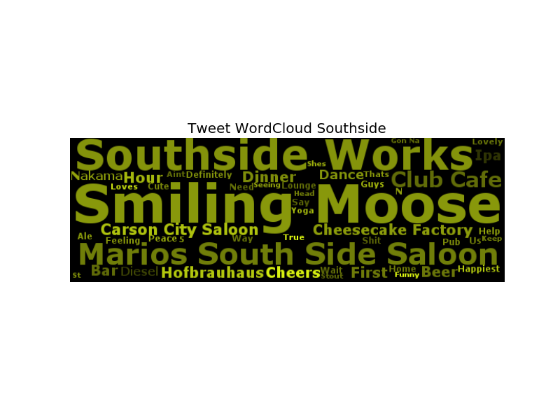
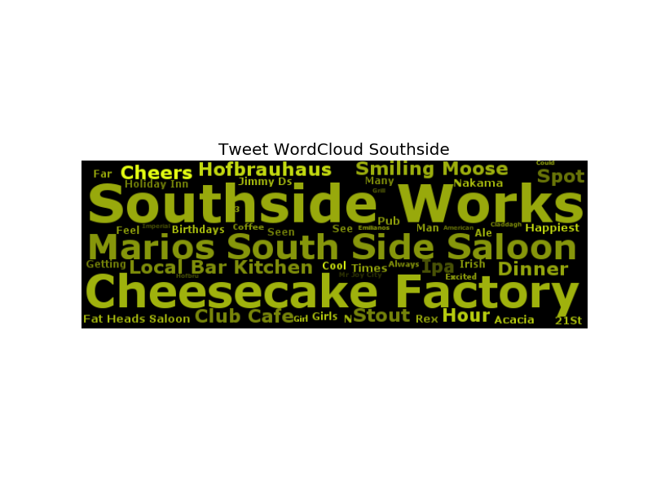
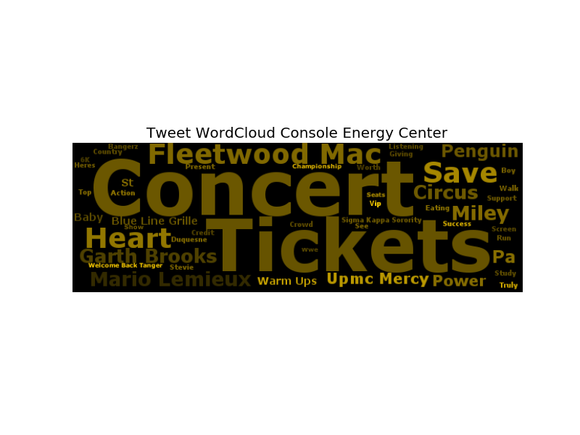
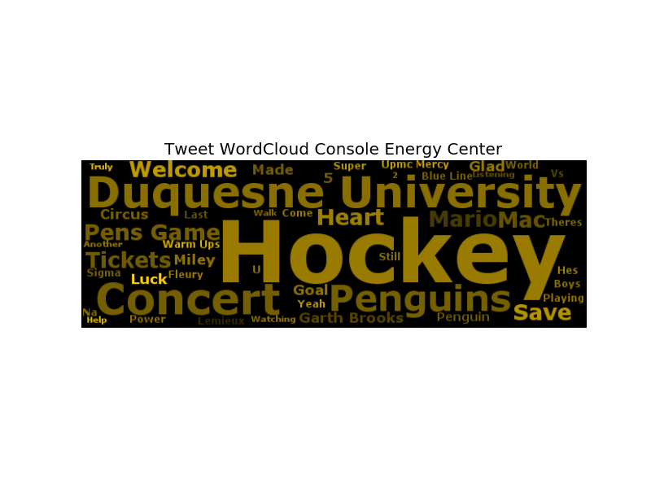
To address this issue, another tf-idf is considered, which evaluates the importance of a term for a specific user.
Therefore, the user-effect could excluded by dividing cluster tf-idf with user tf-idf standard deviation…
‘Smiling Moose’ may not be as popular as it is at first glance.
Hockey is still the main purpose for most people heading to Console Energy Center

Slide 43
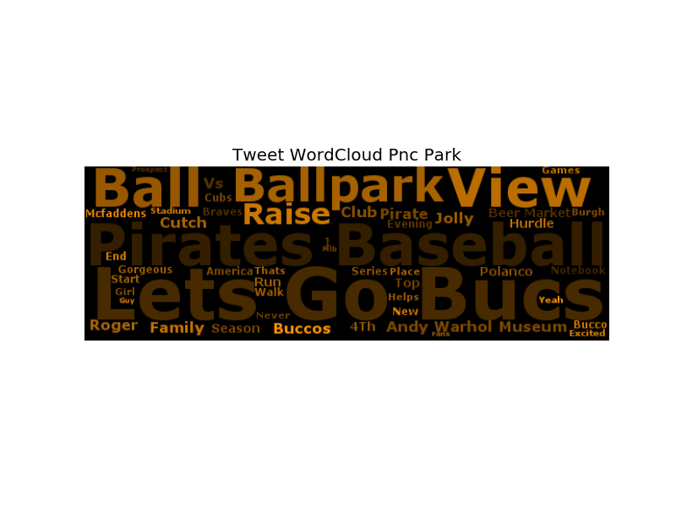
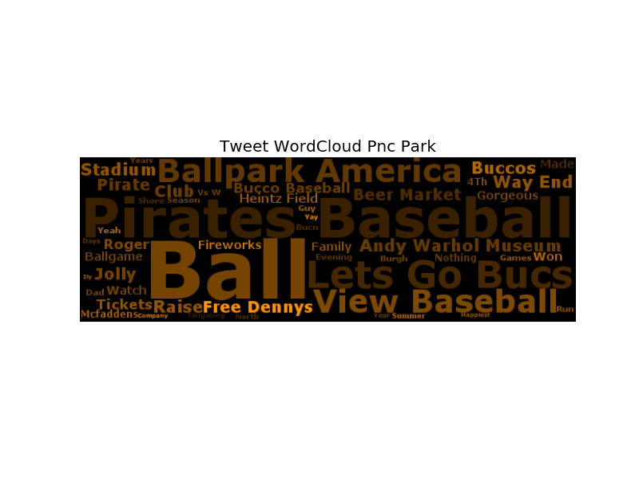
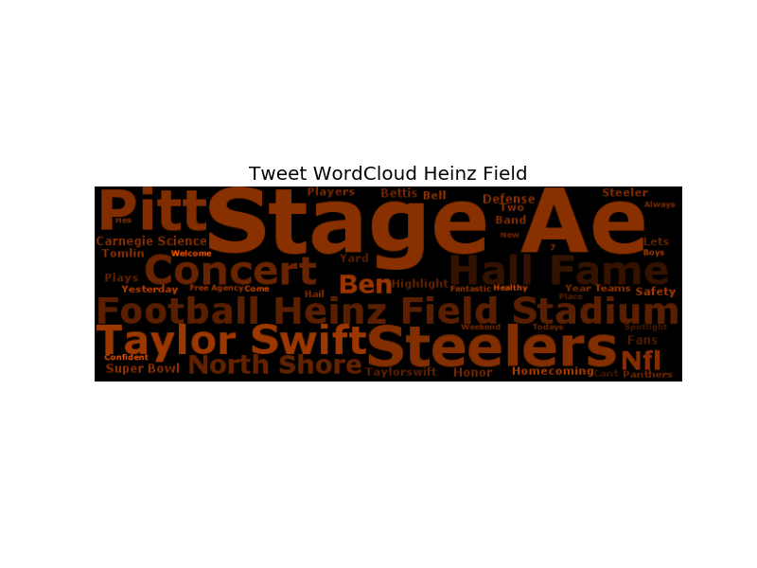
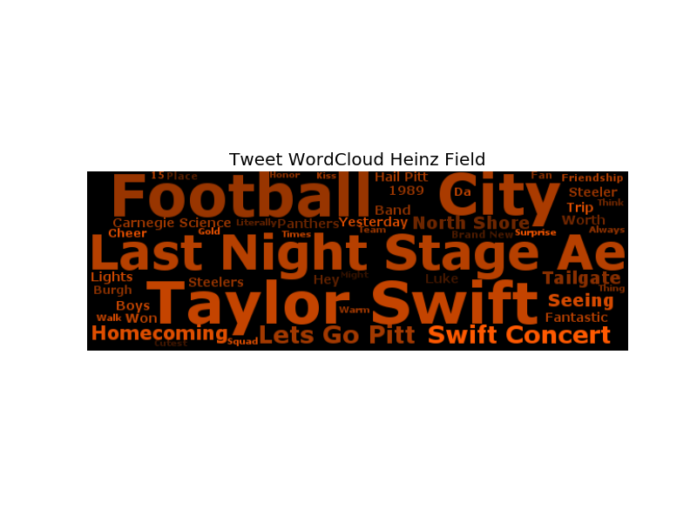
To address this issue, another tf-idf is considered, which evaluates the importance of a term for a specific user.
Therefore, the user-effect could excluded by dividing cluster tf-idf with user tf-idf standard deviation…
It seems many people enjoyed Taylor Swifts concert last year.
Most tweets containing ‘steeler’ were posted by ‘SteelTownUsa’.

Slide 44
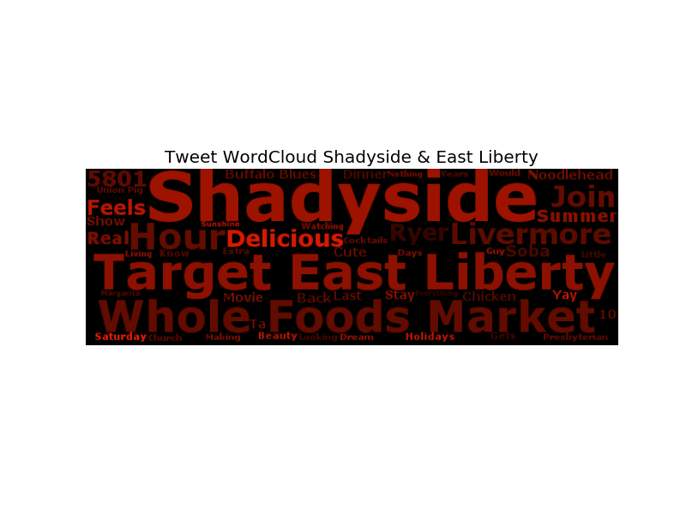
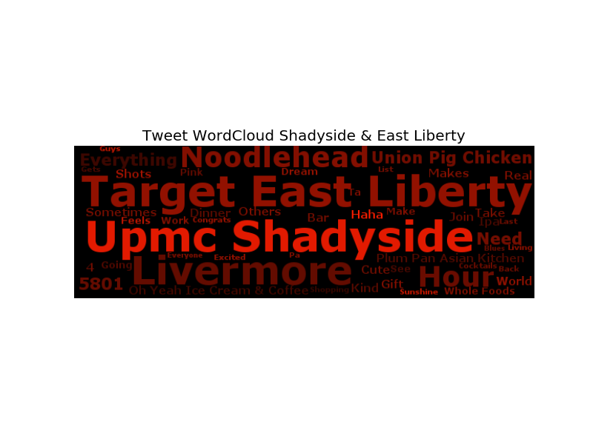
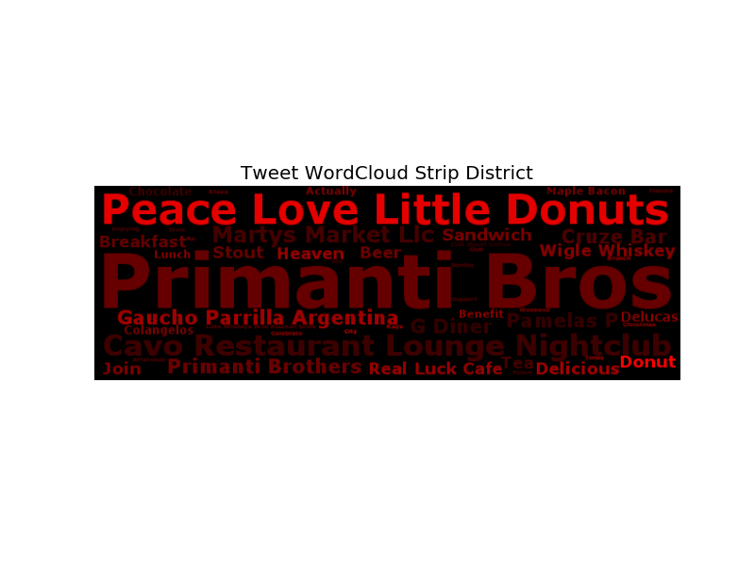
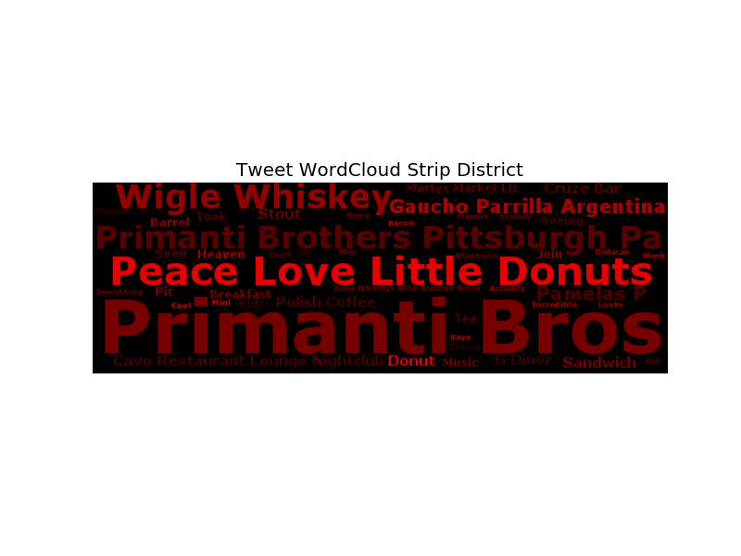
To address this issue, another tf-idf is considered, which evaluates the importance of a term for a specific user.
Therefore, the user-effect could excluded by dividing cluster tf-idf with user tf-idf standard deviation…
UPMC is not in the original wordcloud, not shows up after considering user impact.
More good restaurants in Strip District pop up, but the lightest color of ‘Peace Love Little Donuts’ is due to its tricky name.

Slide 45
Some findings:
The wordcloud based on tf-idf score and sentiment value visualizes hot topics, popular places and events in different urban areas. However, user impacts on the term tf-idf score should be considered.
Terms that are popular among most people could be better recognized if the cluster-based tf-idf is normalized by user-based tf-idf.
This method could also be used in user classification, differentiating organizations from individuals.

Slide 46
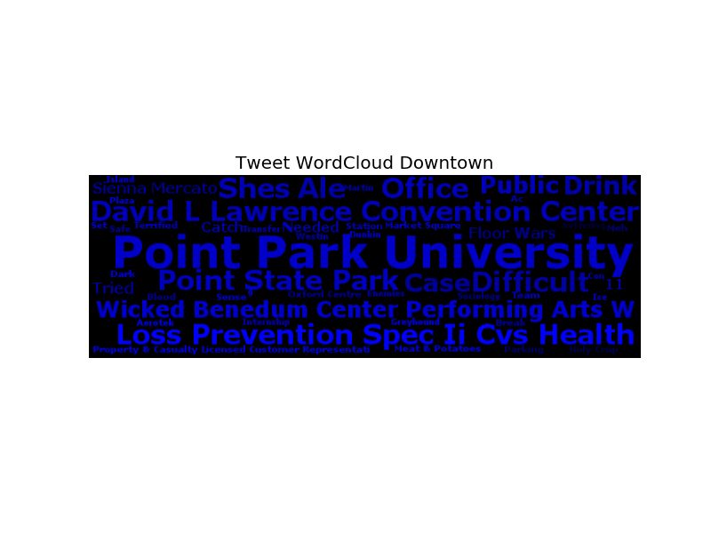
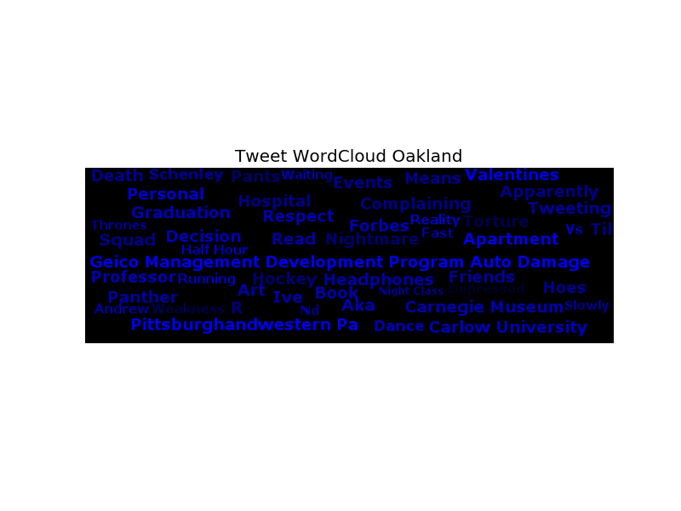
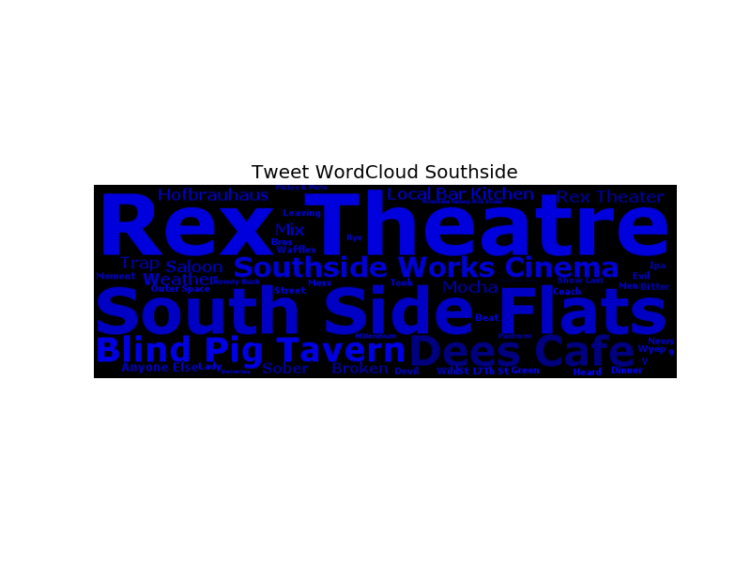
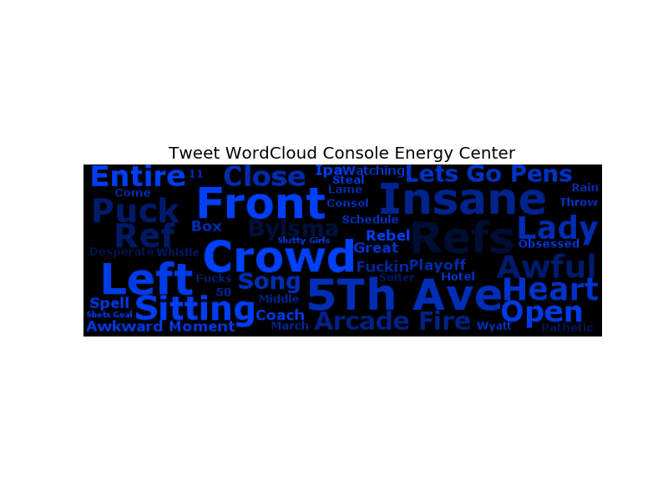
How about unhappy tweets?
Wordclouds of unhappy tweets are created following the same method…

Slide 47
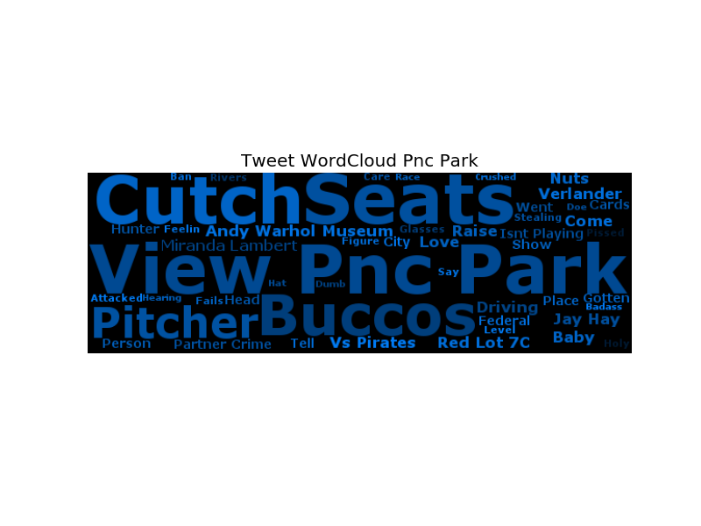
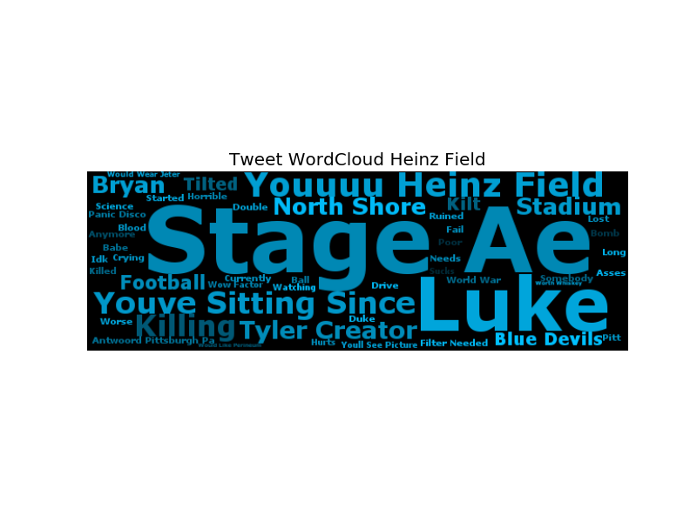
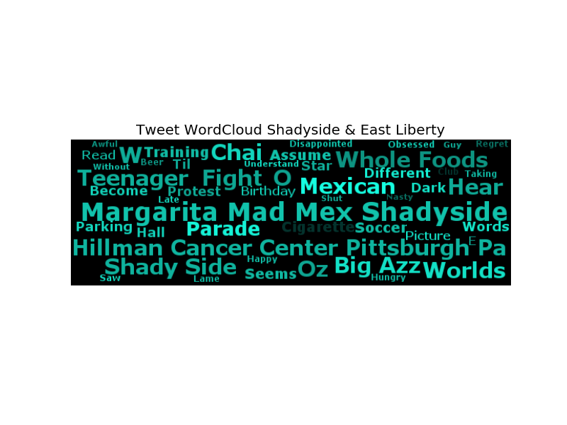
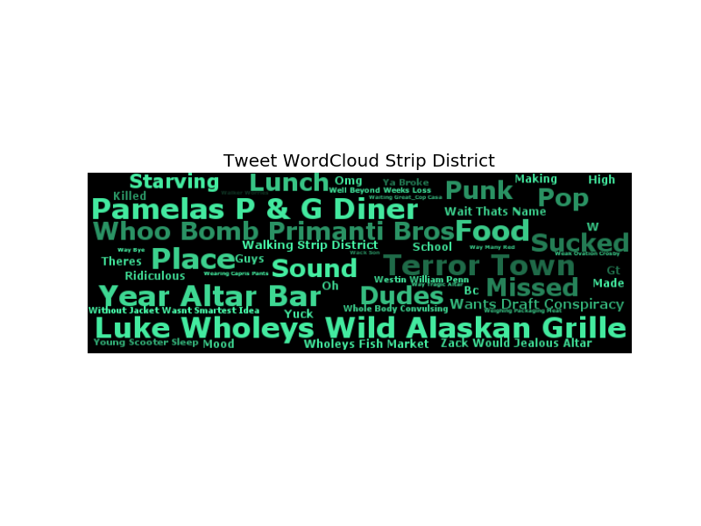
How about unhappy tweets?
Wordclouds of unhappy tweets are created following the same method…

Slide 48
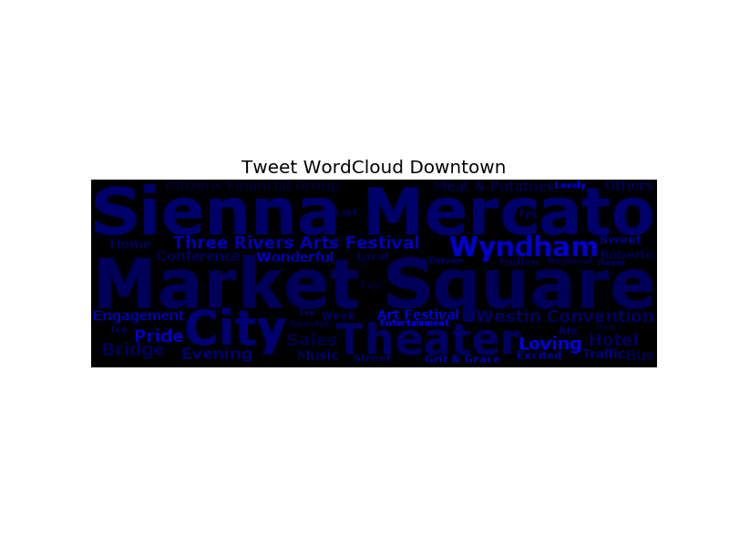
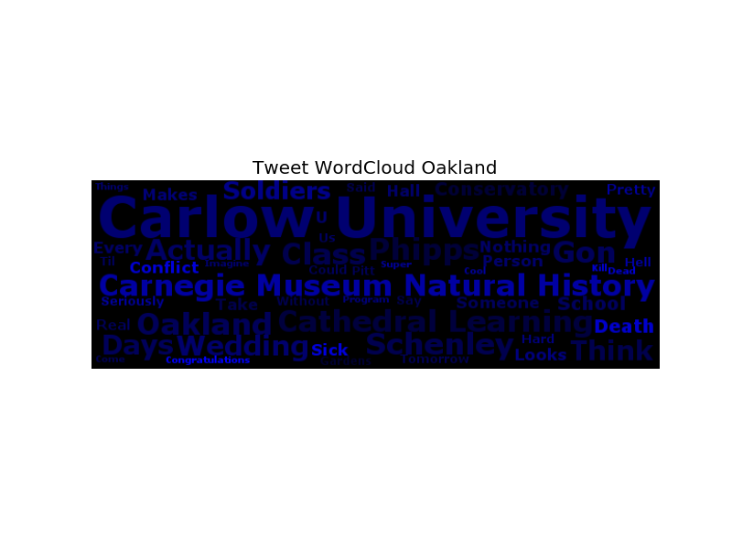
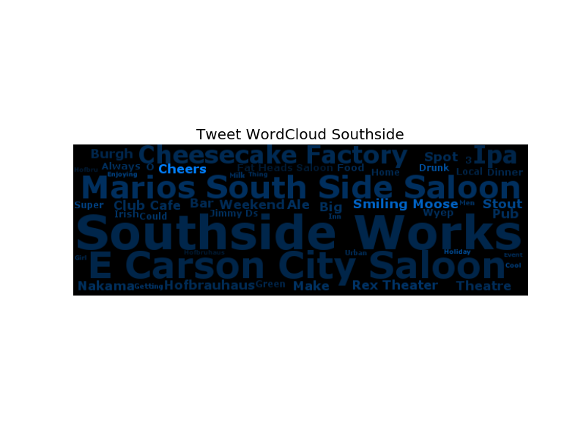
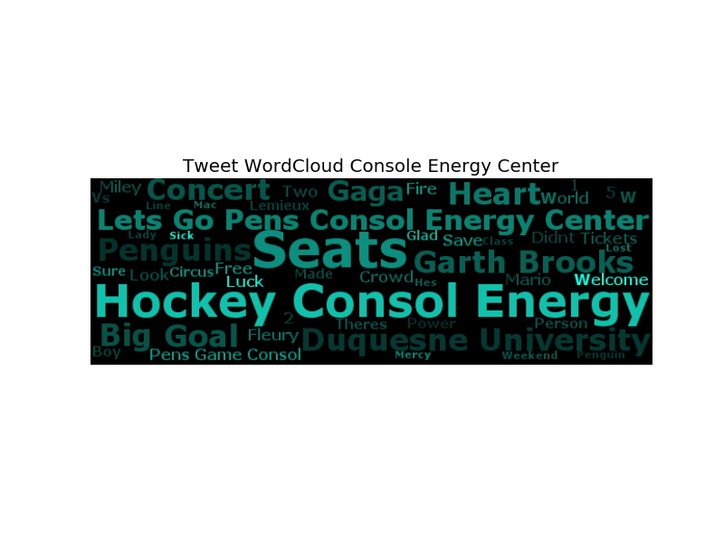
What if we generalize happy and unhappy tweets into emotional tweets?
Wordclouds of emotional tweets (happy/unhappy) are created following the same method…

Slide 49
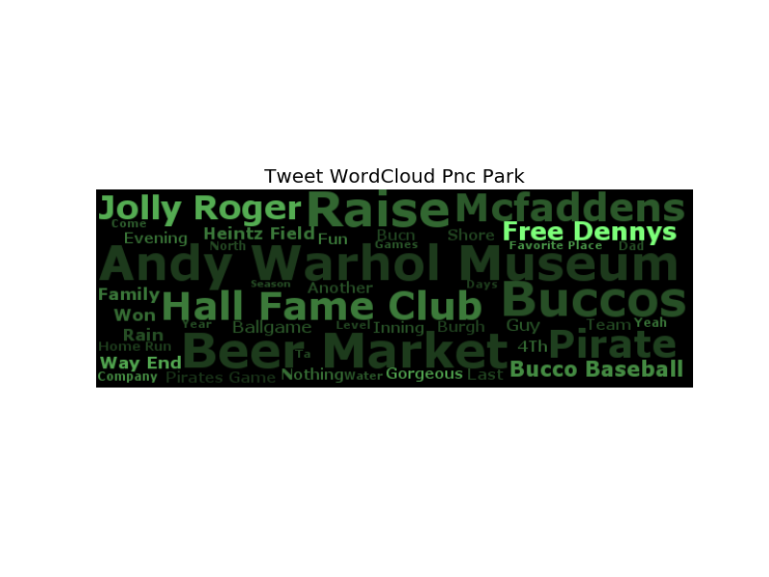
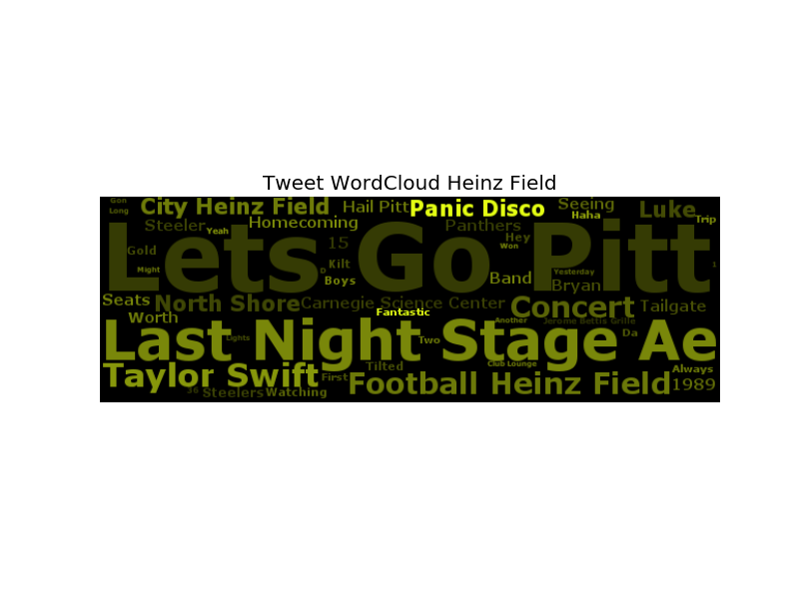
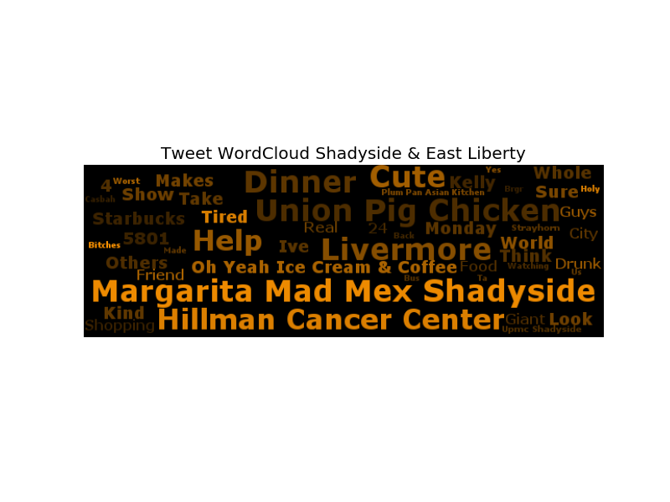
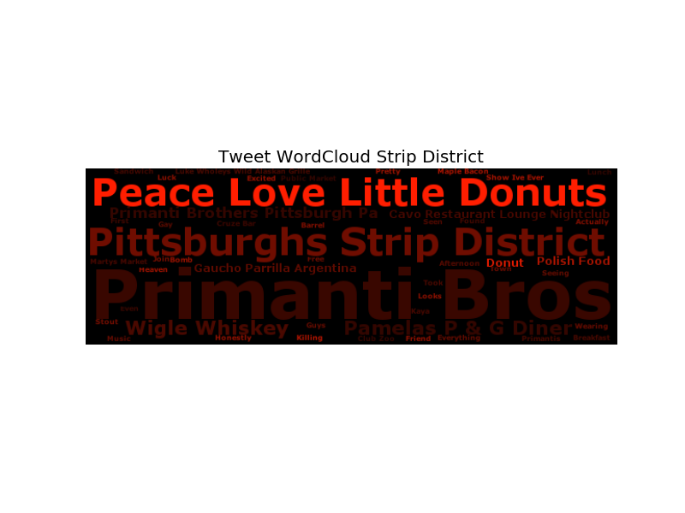
What if we generalize happy and unhappy tweets into emotional tweets?
Wordclouds of emotional tweets (happy/unhappy) are created following the same method…

Slide 50
Some findings:
Even though more noisy, local venues are also popping up from unhappy tweet wordclouds. Some of them appear in wordclouds of happy tweets as well. Therefore, it is hard to say these places are making people happy or unhappy.
In addition, specific words in venue names give incorrect sentiment prediction. (e.g. ‘Peace Love Little Donuts’ vs ‘Mad Mex’)
However, we may conclude that local venues are more likely to cause emotion, either make people feel happy or unhappy.
Therefore, it becomes interesting to study the relationship between tweet sentiment strength and urban functions in certain areas.

Slide 51
URBAN FUNCTIONS

Slide 52
# of auto-tweets by category…
% of auto-tweets by category…

Slide 53
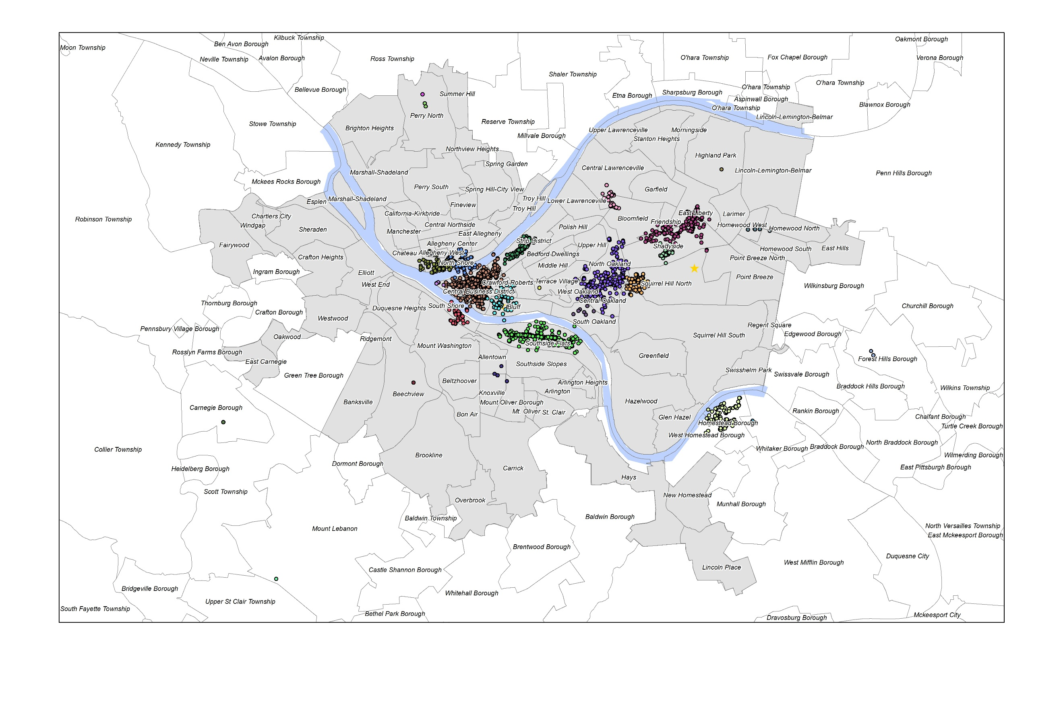
Extract venue check-ins from Foursquare and Instagram auto-tweets, and then merge into clusters…

Slide 54
Numbers of venue extracted from Foursquare and Instagram auto-tweets…
clid |  | all | 4sq | inst | clid |  | all | 4sq | inst
0 | downtown | 3008 | 2302 | 706 | 16 | beechview | 1 | 0 | 1
1 | oakland | 797 | 642 | 155 | 17 | upper st clair township-mount lebanon | 1 | 0 | 1
2 | southside | 1514 | 1386 | 128 | 18 | terrace village | 1 | 0 | 1
3 | console energy center | 747 | 657 | 90 | 19 | lawrenceville-liberty & bloomfield | 127 | 123 | 4
4 | northside-pnc park | 1174 | 910 | 264 | 20 | shaler township | 0 | 0 | 0
5 | northside-heinz field | 481 | 375 | 106 | 21 | perry north-ross township | 1 | 0 | 1
6 | shadyside-east liberty | 873 | 831 | 42 | 22 | shadyside-walnut | 691 | 679 | 12
7 | strip district | 741 | 644 | 97 | 23 | perry north | 2 | 2 | 0
8 | homewood | 24 | 20 | 4 | 24 | carnegie borough | 1 | 1 | 0
9 | homestead-waterfront | 1112 | 1088 | 24 | 25 | foresthills borough | 3 | 3 | 0
10 | pittsburgh tech center | 29 | 19 | 10 | 26 | homestead | 47 | 31 | 16
11 | cmu | 358 | 335 | 23 | 27 | middle hill | 0 | 0 | 0
12 | southside-brownsville & allington | 15 | 15 | 0 | 28 | hazelwood | 0 | 0 | 0
13 | overbrook | 0 | 0 | 0 | 29 | carrick | 0 | 0 | 0
14 | station square | 215 | 157 | 58 | 30 | highland park | 1 | 0 | 1
15 | point state | 38 | 13 | 25 | 31 | perry south | 0 | 0 | 0

Slide 55
Numbers of venue extracted from Foursquare and Instgram auto-tweets…

Slide 56
Temporal venue checkins and tweet sentiment by hour of week…
SUN
MON
TUE
WED
THU
FRI
SAT
SUN
MON
TUE
WED
THU
FRI
SAT

Slide 57
Is there any correlation between urban emotion and venue checkin?
If so, is venue checkin correlated with urban happiness or sentiment strength?
Pearson correlation coefficients between tweet sentiment and venue checkin by hour of week…
clid |  | senti | senti_abs | pos_n | neg_n
 | pittsburgh | 0.6151 | 0.5677 | 0.6723 | 0.4839
0 | downtown | 0.5866 | 0.7949 | 0.7885 | 0.6195
2 | southside | 0.3865 | 0.8046 | 0.7907 | 0.6672
4 | northside-pnc park | 0.5691 | 0.7197 | 0.7037 | 0.5858
9 | homestead-waterfront | 0.2125 | 0.6338 | 0.5991 | 0.5084
6 | shadyside-east liberty | 0.1873 | 0.6256 | 0.5446 | 0.4118
1 | oakland | 0.2751 | 0.5016 | 0.5254 | 0.3557
3 | console energy center | 0.5401 | 0.4994 | 0.5076 | 0.3422
7 | strip district | 0.4587 | 0.6708 | 0.6273 | 0.3678
22 | shadyside-walnut | 0.1503 | 0.3316 | 0.2431 | 0.1404
5 | northside-heinz field | 0.2891 | 0.48 | 0.4333 | 0.4345

Slide 58
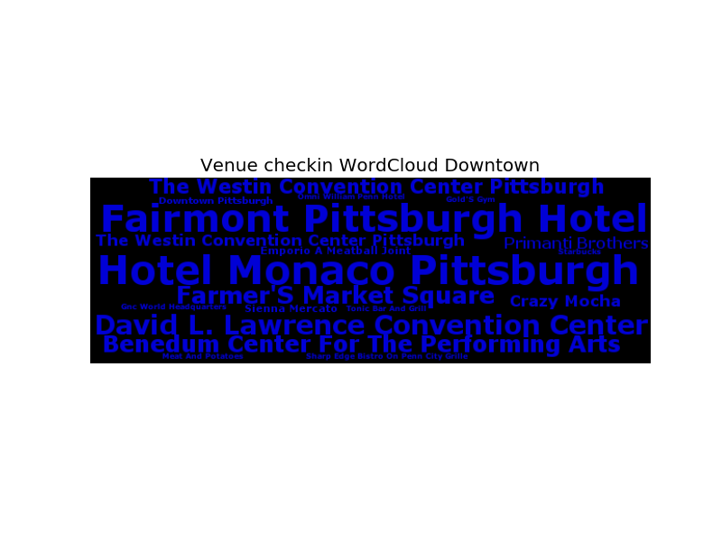
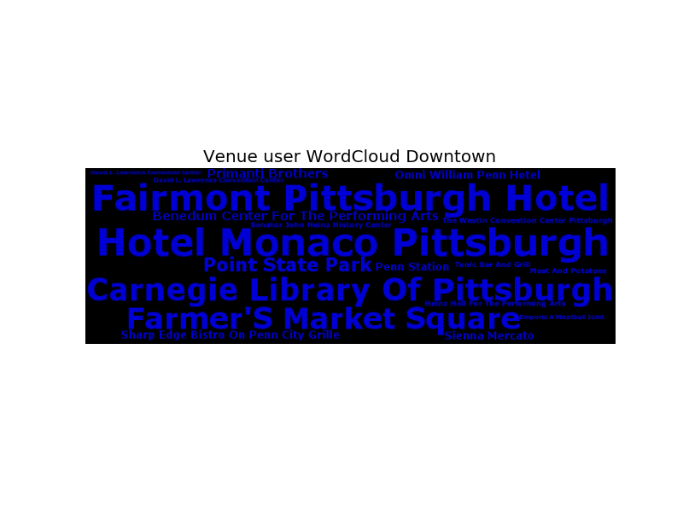
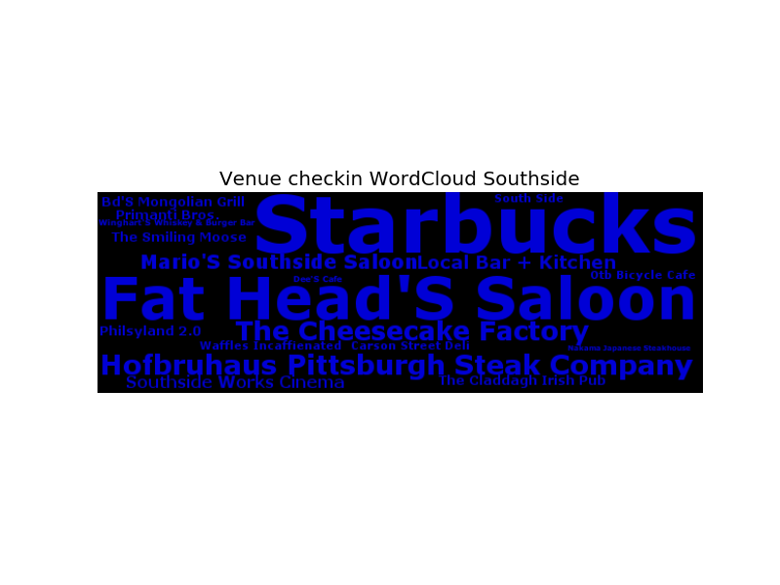
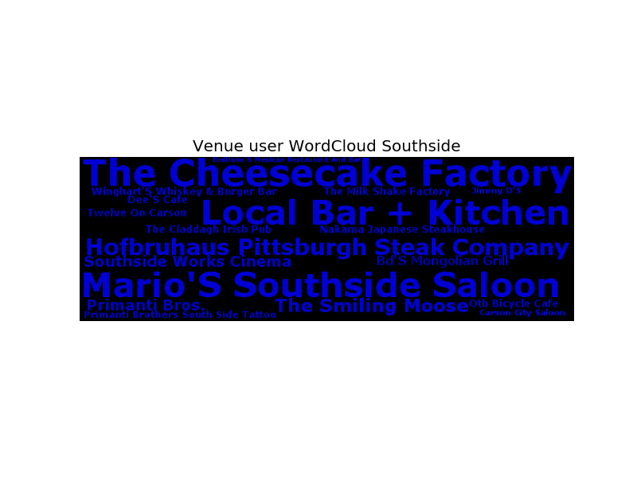
Similar to tweet wordclouds, we could visualize popular venues of each cluster based on their checkin and users…

Slide 59
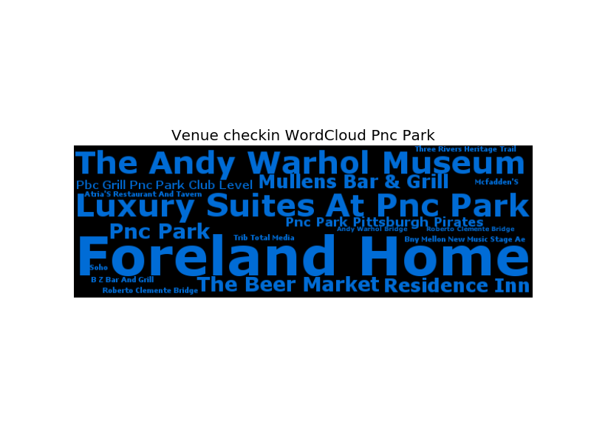
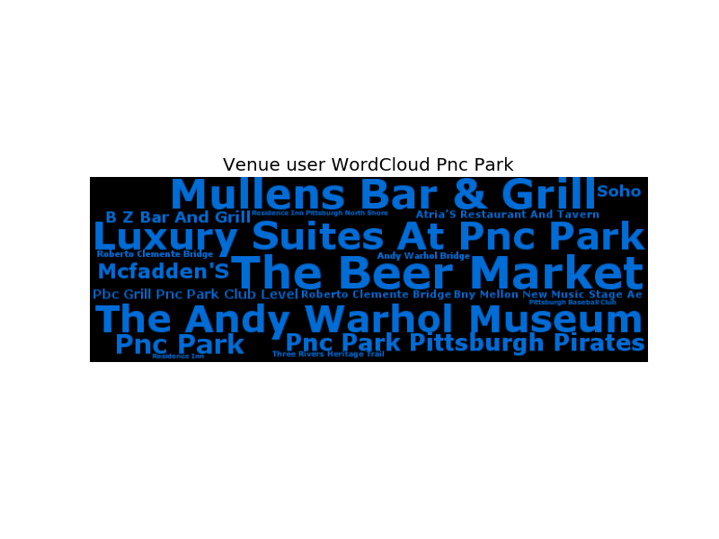
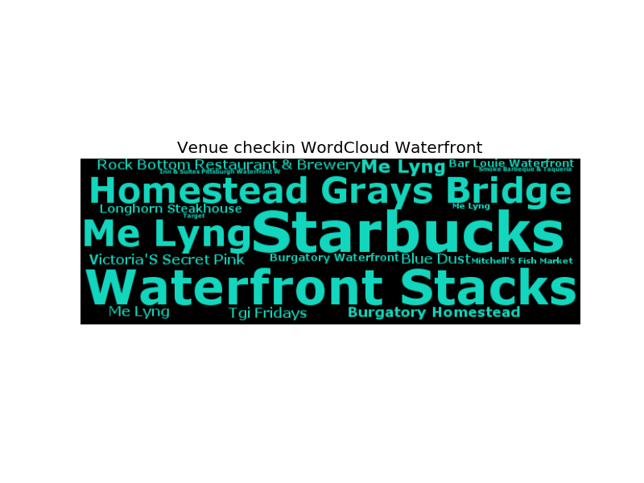
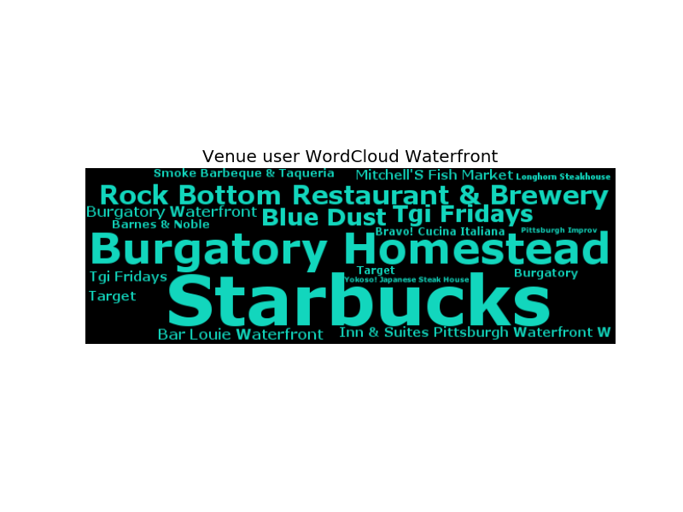
Similar to tweet wordclouds, we could visualize popular venues of each cluster based on their checkin and users…

Slide 60




Similar to tweet wordclouds, we could visualize popular venues of each cluster based on their checkin counts…

Slide 61




Similar to tweet wordclouds, we could visualize popular venues of each cluster based on their checkin counts…

Slide 62
Some findings:
Venues could be extracted from Foursquare and Instgram auto-generated tweets.
Temporal venue checkins are positively correlated with tweet happiness over the city and several clusters.
For other clusters, venue checkins are only correlated with tweet sentiment strength, which means certain urban activities make people feel more emotional or tend to express emotion.
Venues distribute unevenly in the city, and each cluster has different type of popular venues. By comparing wordclouds generated from checkins and users, we could learn whether certain venues are popular over the city, or just attract a specific group of people

Slide 63
Question:
Is there any correlation between tweet happiness and certain venue category?
If we generalize venue categories as different urban use, what is the temporal pattern of urban functions?
Foursquare gives 9 main categories. By searching venue name and coordinates through Foursquare API, we could get the categories of most venues.
clid | pitts | 0 | 2 | 4 | 9 | 6 | 1 | 3 | 7 | 22 | 5
Arts & Entertainment | 88 | 25 | 10 | 7 | 3 | 6 | 11 | 3 | 6 | 0 | 9
College & University | 101 | 9 | 0 | 1 | 0 | 0 | 25 | 17 | 0 | 0 | 5
Event | 0 | 0 | 0 | 0 | 0 | 0 | 0 | 0 | 0 | 0 | 0
Food | 360 | 118 | 54 | 10 | 18 | 30 | 47 | 10 | 36 | 15 | 4
Nightlife Spot | 130 | 23 | 46 | 6 | 4 | 7 | 11 | 7 | 14 | 5 | 1
Outdoors & Recreation | 80 | 27 | 9 | 10 | 4 | 4 | 4 | 1 | 2 | 3 | 5
Professional & Other Places | 209 | 80 | 9 | 7 | 8 | 32 | 26 | 11 | 5 | 4 | 5
Residence | 10 | 3 | 3 | 0 | 0 | 2 | 2 | 0 | 0 | 0 | 0
Shop & Service | 143 | 22 | 37 | 2 | 10 | 19 | 13 | 2 | 22 | 12 | 0
Travel & Transport | 50 | 25 | 3 | 3 | 0 | 3 | 3 | 2 | 0 | 1 | 2
Others | 522 | 153 | 59 | 26 | 29 | 37 | 63 | 20 | 27 | 16 | 37
Total | 1693 | 485 | 230 | 72 | 76 | 140 | 205 | 73 | 112 | 56 | 68

Slide 64


Slide 65
Temporal venue checkins of each category by hour of week…
SUN
MON
TUE
WED
THU
FRI
SAT
SUN
MON
TUE
WED
THU
FRI
SAT

Slide 66
% of temporal venue checkin of each category by hour of week…
SUN
MON
TUE
WED
THU
FRI
SAT

Slide 67
Temporal venue checkins of each category by hour of week…
SUN
MON
TUE
WED
THU
FRI
SAT
SUN
MON
TUE
WED
THU
FRI
SAT

Slide 68
Temporal venue checkins of each category by hour of week…
SUN
MON
TUE
WED
THU
FRI
SAT
SUN
MON
TUE
WED
THU
FRI
SAT

Slide 69
Temporal venue checkins of each category by hour of week…
SUN
MON
TUE
WED
THU
FRI
SAT
SUN
MON
TUE
WED
THU
FRI
SAT

Slide 70
Is there any correlation between urban happiness and urban use?
Pearson correlation coefficients at city level…
use | senti | senti_abs | pos_n | neg_n
College & University | 0.355 | 0.1722 | 0.2379 | 0.1414
Food | 0.6791 | 0.48 | 0.5937 | 0.3858
Residence | 0.1242 | 0.1855 | 0.2043 | 0.166
Travel & Transport | 0.3511 | 0.4253 | 0.4809 | 0.3765
Outdoors & Recreation | 0.4529 | 0.2407 | 0.3172 | 0.1877
Arts & Entertainment | 0.5079 | 0.4407 | 0.5288 | 0.3699
Shop & Service | 0.5197 | 0.3795 | 0.4688 | 0.3152
Nightlife Spot | 0.1535 | 0.6175 | 0.6386 | 0.5756
Professional & Other Places | 0.5371 | 0.0253 | 0.1161 | -0.036
Others | 0.5699 | 0.5278 | 0.6231 | 0.4507

Slide 71
Pearson correlation coefficients at cluster level…
 | downtown |  |  |  | southside |  |  |  | pnc park |  |  |  | waterfront
use | senti | senti_abs | pos_n | neg_n | senti | senti_abs | pos_n | neg_n | senti | senti_abs | pos_n | neg_n | senti | senti_abs | pos_n | neg_n
College & University | 0.098 | 0.1817 | 0.1845 | 0.116 | -- | -- | -- | -- | 0.0495 | -0.0078 | -0.0008 | -0.0416 | -- | -- | -- | --
Food | 0.514 | 0.7182 | 0.6996 | 0.592 | 0.4245 | 0.5902 | 0.6023 | 0.4193 | 0.3525 | 0.3715 | 0.3754 | 0.3354 | 0.1968 | 0.687 | 0.5971 | 0.568
Residence | 0.0732 | 0.1942 | 0.1793 | 0.1789 | 0.3092 | 0.1218 | 0.1508 | 0.0084 | -- | -- | -- | -- | -- | -- | -- | --
Travel & Transport | 0.3252 | 0.4622 | 0.4581 | 0.3805 | -0.0425 | 0.1165 | 0.0856 | 0.136 | 0.0346 | 0.1139 | 0.0893 | 0.1672 | -- | -- | -- | --
Outdoors & Recreation | 0.2556 | 0.4705 | 0.4273 | 0.3836 | 0.0622 | -0.0431 | -0.0312 | -0.0864 | 0.3525 | 0.3672 | 0.3939 | 0.3243 | 0.1414 | 0.1695 | 0.2418 | 0.1131
Arts & Entertainment | 0.3809 | 0.3651 | 0.4095 | 0.2203 | 0.1001 | 0.6078 | 0.5776 | 0.5865 | 0.4991 | 0.6496 | 0.6329 | 0.5123 | 0.2524 | 0.6483 | 0.6133 | 0.5066
Shop & Service | 0.0872 | 0.3485 | 0.265 | 0.3313 | 0.3856 | 0.28 | 0.3572 | 0.1189 | -0.0936 | -0.0304 | -0.0481 | 0.0363 | 0.0566 | 0.3349 | 0.3048 | 0.2942
Nightlife Spot | 0.4149 | 0.2668 | 0.3719 | 0.1588 | 0.236 | 0.8219 | 0.7857 | 0.7456 | 0.3887 | 0.5222 | 0.5101 | 0.4716 | 0.0476 | 0.3351 | 0.3089 | 0.2352
Professional & Other Places | 0.2293 | 0.5475 | 0.4656 | 0.4938 | -0.0713 | -0.0254 | -0.0659 | -0.0186 | 0.0015 | -0.031 | -0.0225 | -0.0471 | 0.0012 | -0.0343 | -0.0384 | -0.059
Others | 0.6157 | 0.6599 | 0.7083 | 0.4443 | 0.2843 | 0.5207 | 0.5099 | 0.4175 | 0.3898 | 0.49 | 0.4587 | 0.4351 | 0.1138 | 0.2379 | 0.2446 | 0.1927

Slide 72
Pearson correlation coefficients at cluster level…
 | downtown |  |  |  | southside |  |  |  | waterfront |  |  |  | shadyside & east liberty
use | senti | senti_abs | pos_n | neg_n | senti | senti_abs | pos_n | neg_n | senti | senti_abs | pos_n | neg_n | senti | senti_abs | pos_n | neg_n
College & University | 0.098 | 0.1817 | 0.1845 | 0.116 | -- | -- | -- | -- | -- | -- | -- | -- | -- | -- | -- | --
Food | 0.514 | 0.7182 | 0.6996 | 0.592 | 0.4245 | 0.5902 | 0.6023 | 0.4193 | 0.1968 | 0.687 | 0.5971 | 0.568 | 0.1984 | 0.3269 | 0.3084 | 0.1476
Residence | 0.0732 | 0.1942 | 0.1793 | 0.1789 | 0.3092 | 0.1218 | 0.1508 | 0.0084 | -- | -- | -- | -- | 0.013 | 0.0888 | 0.0233 | 0.0911
Travel & Transport | 0.3252 | 0.4622 | 0.4581 | 0.3805 | -0.0425 | 0.1165 | 0.0856 | 0.136 | -- | -- | -- | -- | -0.0709 | 0.161 | 0.1628 | 0.1323
Outdoors & Recreation | 0.2556 | 0.4705 | 0.4273 | 0.3836 | 0.0622 | -0.0431 | -0.0312 | -0.0864 | 0.1414 | 0.1695 | 0.2418 | 0.1131 | 0.1031 | 0.1217 | 0.0932 | 0.0925
Arts & Entertainment | 0.3809 | 0.3651 | 0.4095 | 0.2203 | 0.1001 | 0.6078 | 0.5776 | 0.5865 | 0.2524 | 0.6483 | 0.6133 | 0.5066 | -0.0084 | 0.2201 | 0.194 | 0.2509
Shop & Service | 0.0872 | 0.3485 | 0.265 | 0.3313 | 0.3856 | 0.28 | 0.3572 | 0.1189 | 0.0566 | 0.3349 | 0.3048 | 0.2942 | 0.0066 | 0.5828 | 0.4725 | 0.4476
Nightlife Spot | 0.4149 | 0.2668 | 0.3719 | 0.1588 | 0.236 | 0.8219 | 0.7857 | 0.7456 | 0.0476 | 0.3351 | 0.3089 | 0.2352 | -0.0075 | 0.305 | 0.2194 | 0.2553
Professional & Other Places | 0.2293 | 0.5475 | 0.4656 | 0.4938 | -0.0713 | -0.0254 | -0.0659 | -0.0186 | 0.0012 | -0.0343 | -0.0384 | -0.059 | 0.0794 | -0.0563 | -0.0217 | -0.0866
Others | 0.6157 | 0.6599 | 0.7083 | 0.4443 | 0.2843 | 0.5207 | 0.5099 | 0.4175 | 0.1138 | 0.2379 | 0.2446 | 0.1927 | 0.2527 | 0.5087 | 0.4713 | 0.2657

Slide 73
Some findings:
Urban use could be represented by checkins of different venue categories.
Temporal patterns of urban use are different among clusters.
Some clusters have dominant urban functions while some are more mixed-use.
Some urban functions are correlated with tweet happiness or emotion strength.

Slide 74

Using wordclouds, we could better visualize the mixed-use level of each cluster…

Slide 75




Using wordclouds, we could better visualize the mixed-use level of each cluster…

Slide 76
How to evaluate the mixed-use level of each cluster?
Overall entropies among venue categories…
clid |  | entro | clid |  | entro | clid |  | entro
1 | oakland | 2.8293 | 19 | lawrenceville-liberty & bloomfield | 1.6097 | 17 | upper st clair township-mount lebanon | 0
0 | downtown | 2.768 | 10 | pittsburgh tech center | 1.5538 | 18 | terrace village | 0
9 | homestead-waterfront | 2.3624 | 12 | southside-brownsville & allington | 1.4295 | 20 | shaler township | 0
5 | northside-heinz field | 2.3446 | 23 | perry north | 1 | 21 | perry north-ross township | 0
14 | station square | 2.3356 | 11 | cmu | 0.9374 | 24 | carnegie borough | 0
6 | shadyside-east liberty | 2.3233 | 25 | foresthills borough | 0.9183 | 27 | middle hill | 0
7 | strip district | 2.194 | 8 | homewood | 0.549 | 28 | hazelwood | 0
2 | southside | 2.1176 | 15 | point state | 0.5328 | 29 | carrick | 0
22 | shadyside-walnut | 2.0238 | 26 | homestead | 0.2678 | 30 | highland park | 0
3 | console energy center | 1.7553 | 13 | overbrook | 0 | 31 | perry south | 0
4 | northside-pnc park | 1.7045 | 16 | beechview | 0

Slide 77
How to evaluate the mixed-use level of each cluster?
Sum of entropies among venue categories at each hour of week…
clid |  | entro | clid |  | entro | clid |  | entro
0 | downtown | 295.774 | 14 | station square | 63.9341 | 20 | shaler township | 0
1 | oakland | 188.4001 | 11 | cmu | 29.3334 | 21 | perry north-ross township | 0
2 | southside | 178.528 | 19 | lawrenceville-liberty & bloomfield | 14.2636 | 23 | perry north | 0
9 | homestead-waterfront | 169.3661 | 10 | pittsburgh tech center | 4.8113 | 24 | carnegie borough | 0
6 | shadyside-east liberty | 154.1201 | 15 | point state | 1.8366 | 25 | foresthills borough | 0
22 | shadyside-walnut | 130.1147 | 12 | southside-brownsville & allington | 1 | 26 | homestead | 0
7 | strip district | 124.6809 | 8 | homewood | 0 | 27 | middle hill | 0
4 | northside-pnc park | 114.1051 | 13 | overbrook | 0 | 28 | hazelwood | 0
3 | console energy center | 102.0079 | 16 | beechview | 0 | 29 | carrick | 0
5 | northside-heinz field | 93.298 | 17 | upper st clair township-mount lebanon | 0 | 30 | highland park | 0
 |  |  | 18 | terrace village | 0 | 31 | perry south | 0

Slide 78
Some findings:
The mixed-use level of each cluster could be visualized by wordclouds.
The mixed-use level of each cluster could be quantified either by calculating the overall entropy among venue categories or by summing up entropies by hour of week.
(However, the latter measurement is based on the assumption of identical weekly pattern of urban use for each cluster.)

Slide 79
So far, we analyzed the accumulated tweet sentiment and venue checkins…
Could we model the temporal urban use by checkins of each cluster’s representative venue categories?
Are timestamp, cluster and corresponding urban use determinant features of tweet sentiment?

